Slide 1
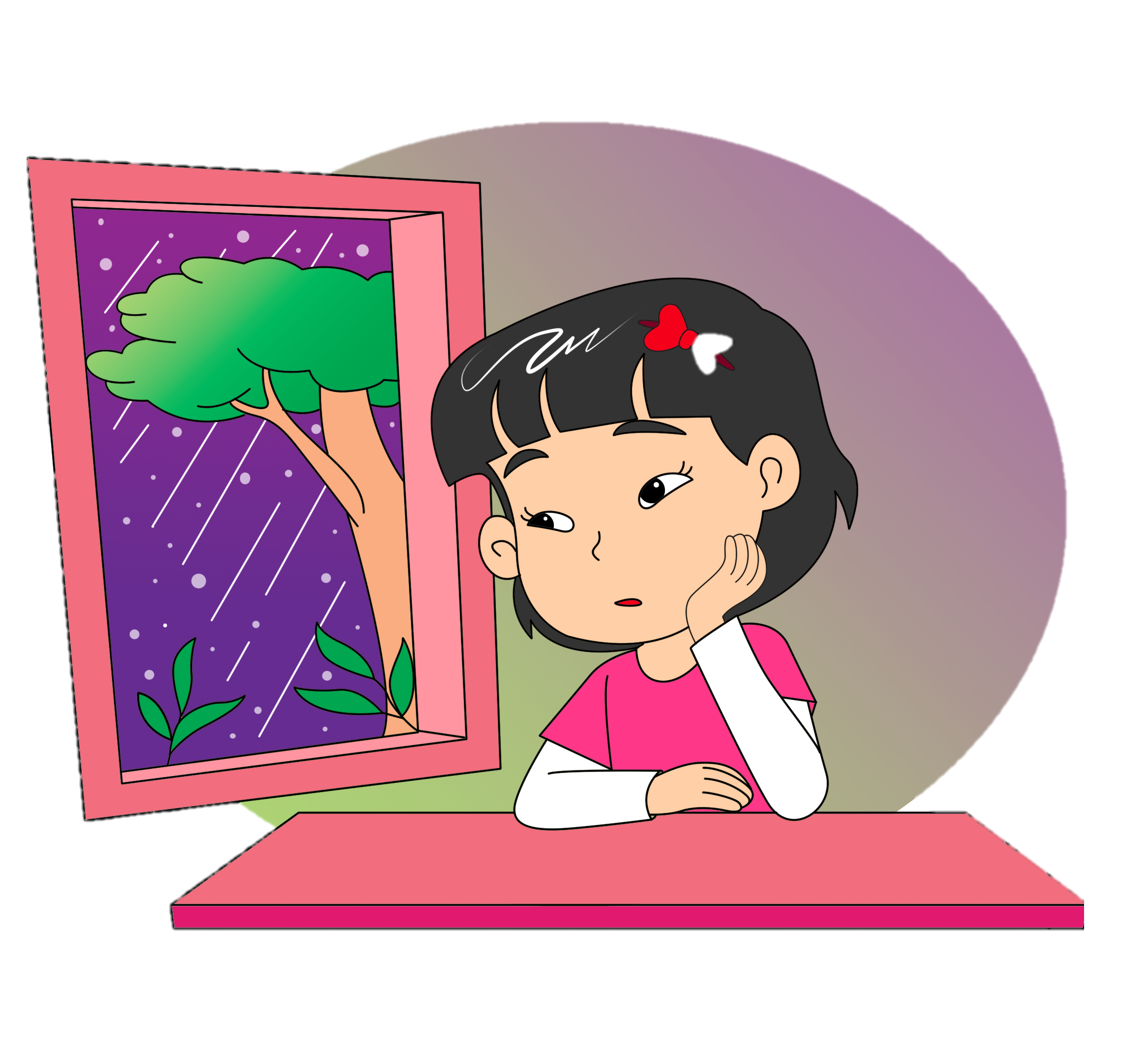
What Do You Do on
a Rainy Day?
8.
Ask about weather
Tell about weather
Theme: Weather

Slide 2
B.
Read aloud.
It is a sunny day.
It is raining.

Slide 3
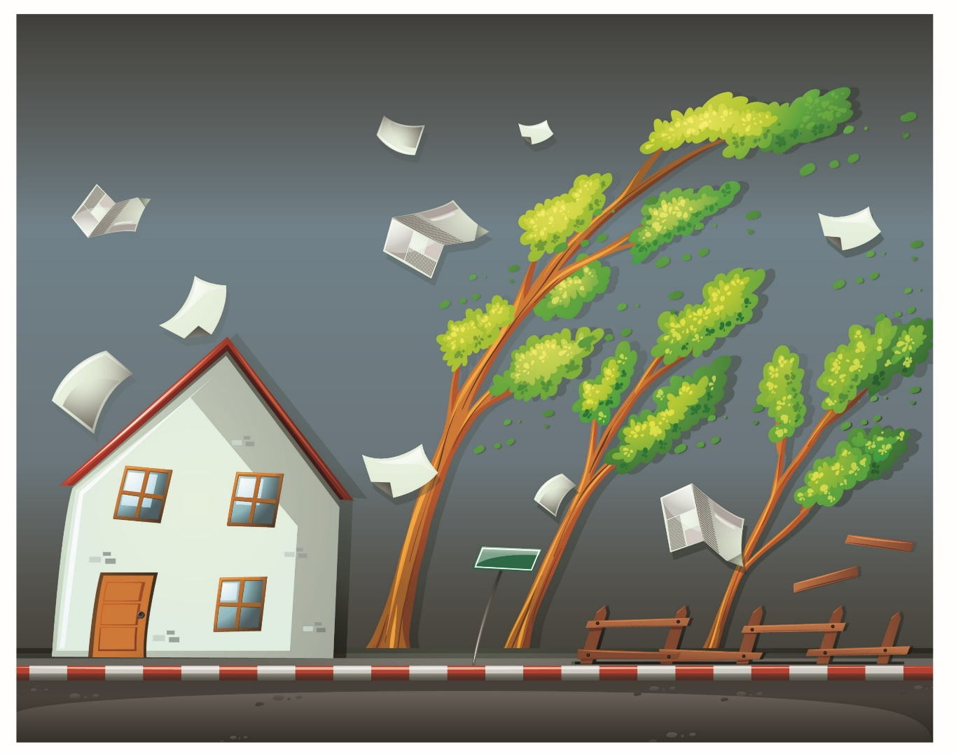
B.
Read aloud.
Look!
There is a rainbow.
It is windy.

Slide 4

B.
Read aloud.
It is cloudy.
It is snowing.

Slide 5
D.
Listen and do.
Put on the raincoat.
Put on the boots.

Slide 6
D.
Listen and do.
Get the umbrella.
Play in the rain.

Slide 7
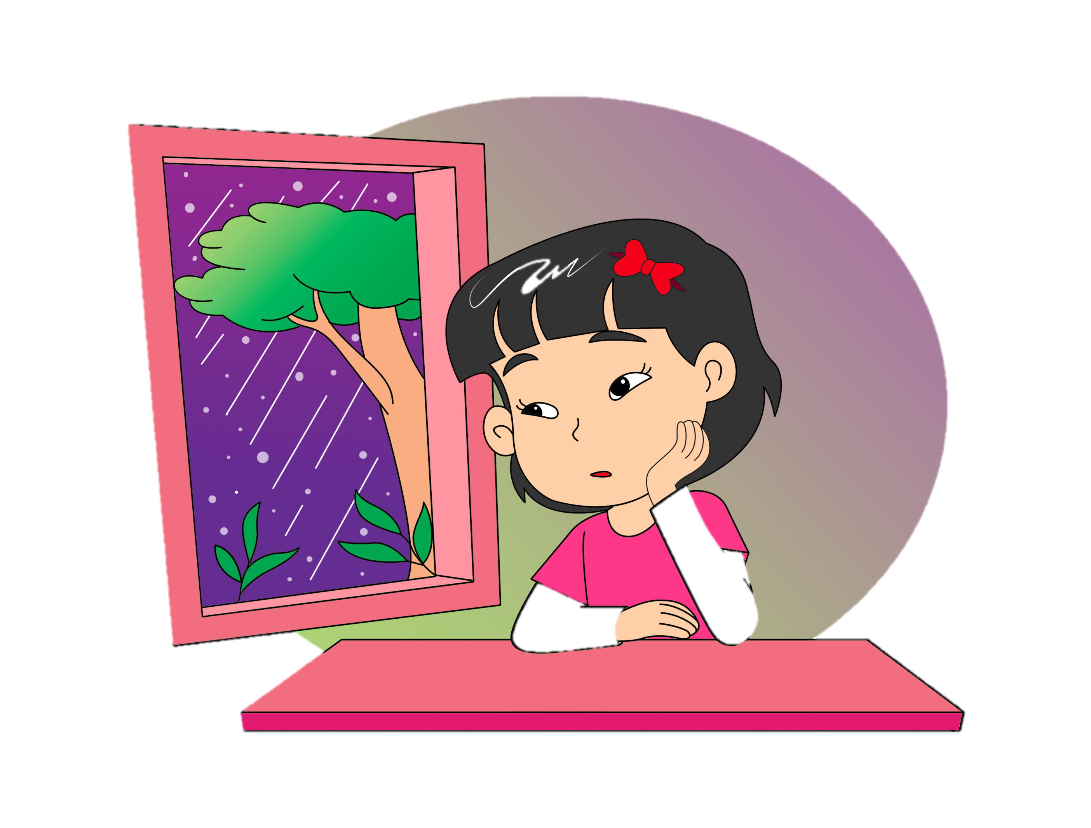
F.
View and sing.
Rain, Rain, Go Away
Rain, rain, go away.
Come again another day.
I want to go out and play.
Rain, rain, go away.

Slide 8
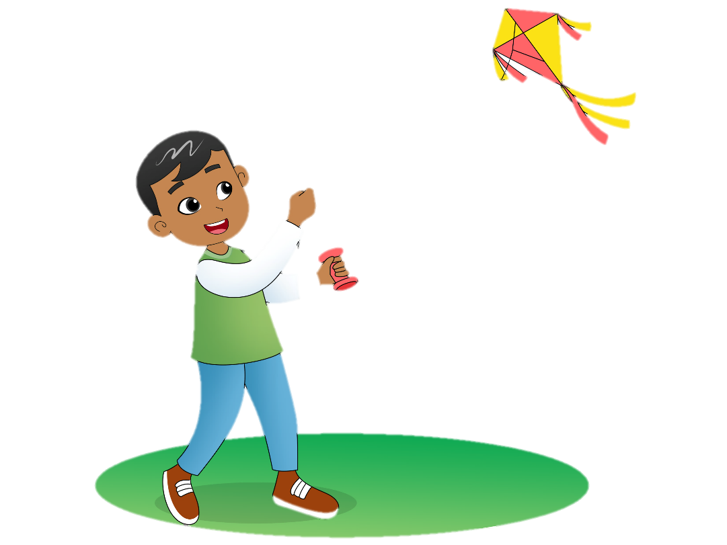
G.
Say a chant.
I’m Happy
I’m happy, I’m happy.
I like the weather today.
I’m happy, I’m happy.
It’s a sunny day.
I’m sad, I’m sad.
I don’t like the weather today.
I’m sad, I’m sad.
It’s rainy day.

Slide 9
J.
Ask your friends.
I usually watch TV on a rainy day.
What do you do on a rainy day?
I usually sleep on a rainy day.

Slide 10
K.
Read for fun.
What Is the Weather Going to Be?
A weather forecast tells us about the weather in the future. It is not an easy thing to do. Scientists collect data about the weather. Then they use a computer program to predict the weather. Is it going to rain? Or, is it going to be sunny?

Slide 11
K.
Read for fun.
However, sometimes it is not hard to predict the weather in the near future. People just go outside and look. Is the sky clear? Are there a lot of dark clouds? Is the air warm or cold? Is there a lot of wind blowing? If it is windy, the air is cold, and the sky is covered with dark clouds, what is going to happen?

