Slide 1
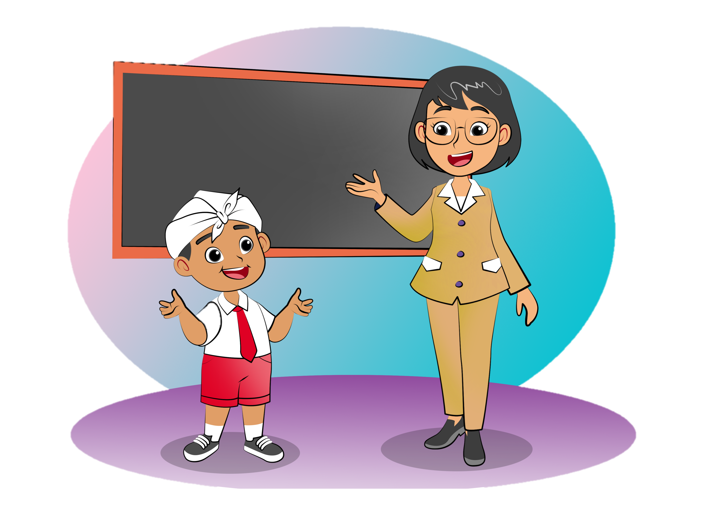
How Do You Spell Blue?
1.
Greet others
Ask names
Spell words
Say farewell
B-L-U-E
Theme: A New Friend

Slide 2
B.
Listen and say.

Slide 3

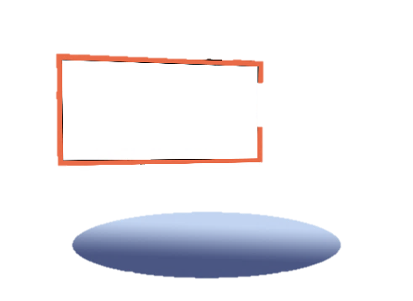

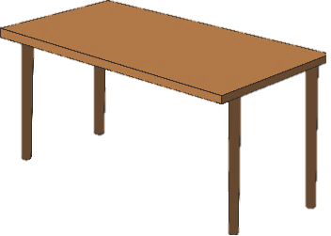
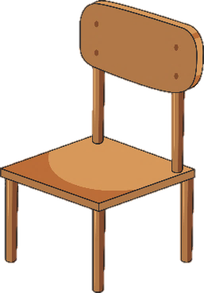




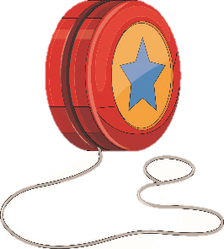
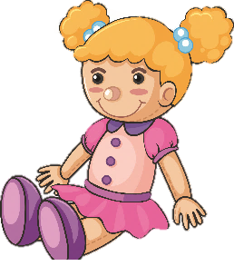
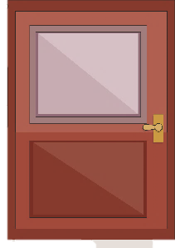

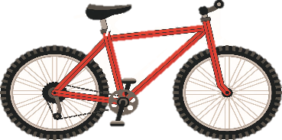
F.
Say a chant.
How Do You Spell Blue?
How do you spell blue? B-L-U-E
How do you spell pink? P-I-N-K
How do you spell gray? G-R-A-Y
How do you spell green? G-R-E-E-N
How do you spell black? B-L-A-C-K

Slide 4
G.
Listen and do.
My name’s Nurul.
Say your name.
Write your name.

Slide 5
G.
Listen and do.
N-U-R-U-L
NURUL
NURUL
Show your name.
Spell your name.

Slide 6
I.
Listen and talk.
Excuse me. What’s your name?
My name’s Kevin.
It’s K-E-V-I-N.
How do you spell your name?
Yes. That’s right.
K-E-V-I-N.
Thank you, Kevin.
You’re welcome.

Slide 7
J.
Listen and say.
Good morning.
Good afternoon.

Slide 8
J.
Listen and say.
Good evening.
Good night.

Slide 9
M.
Listen and talk.
Hi, Nurul.
Hello, Seta.
Not bad. Thanks. How are you?
How are you?
I’m great, Thank you.
Sorry. I have to go now.
Goodbye, Nurul. See you.

Slide 10
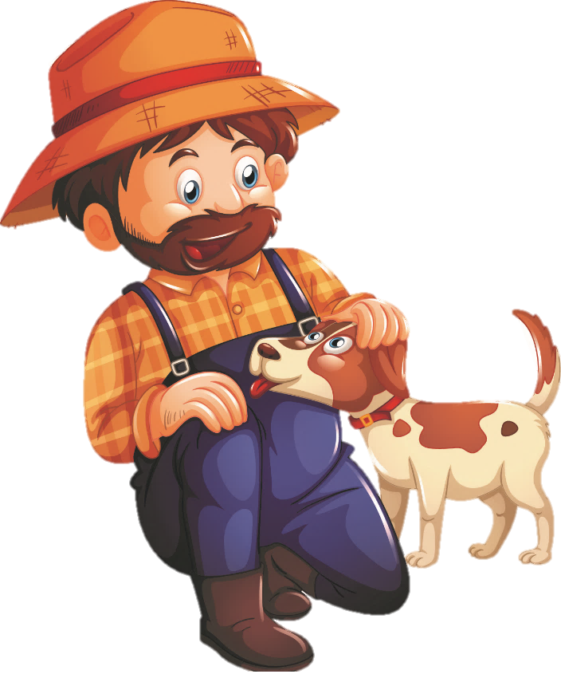
N.
View and sing.
❝
BINGO
There was a farmer who had a dog, and Bingo was his name o.
B-I-N-G-O
B-I-N-G-O
B-I-N-G-O
and BINGO was his name o.
❞

Slide 11
P.
Read for fun.
Good morning, Made.
My friend Dona
This is Dona. She is my friend from Papua. Meatball soup is her favorite food. She goes to school by bike. She always says, “Good morning,” and waves her hand when she meets me.

Slide 12
Q.
Play a game.
P-L-A-Y
Play!
Yes. You’re right.

