Slide 1


Slide 2

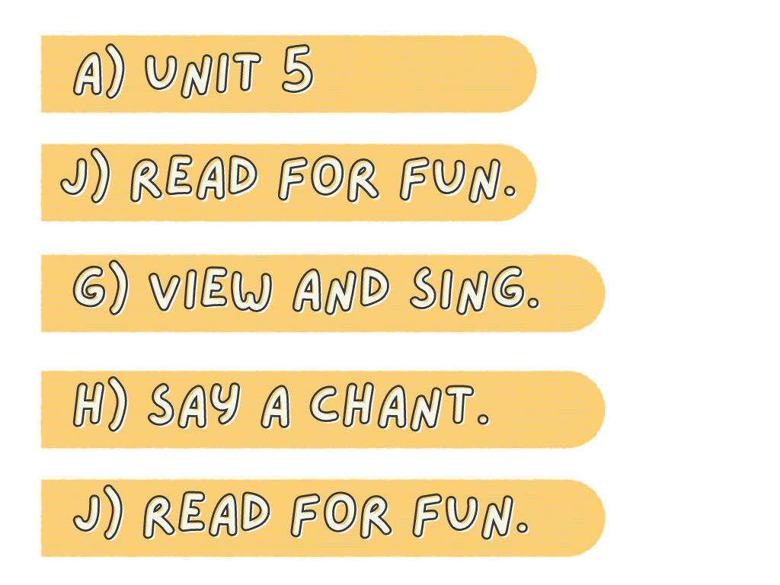
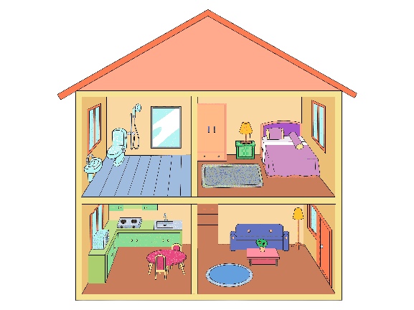
My House
Describe
your house!

Slide 3
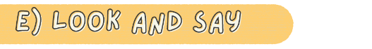

Slide 4
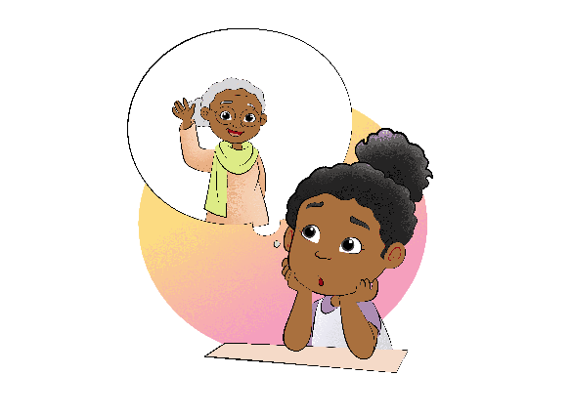
Where's Grandma
Where is grandma,
where is grandma.
Is she out, is she out?
She's not in the kitchen.
She's not in the kitchen.
Where is she?
Do you know?

Slide 5

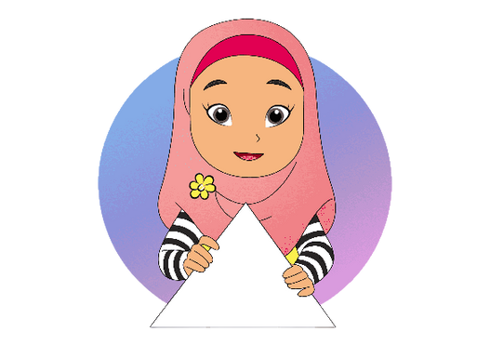

Circle
Triangle

Slide 6


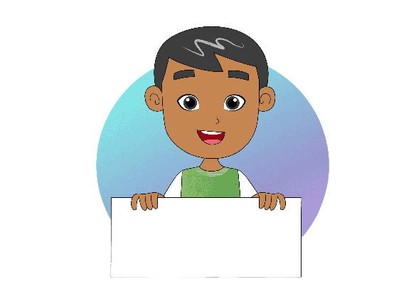

Rectangle
Square

Slide 7
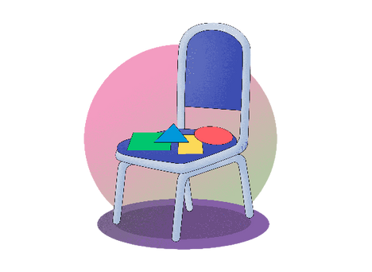

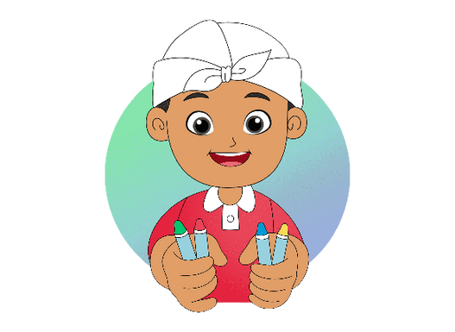
Color
them,
and put them
on the chair.
Color
them,

Slide 8
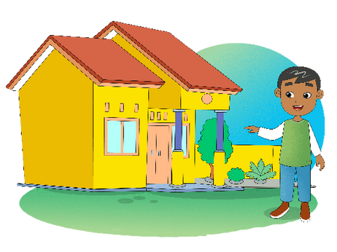
Hi, I am Tigor
This is my house.
It has one kitchen, one bathroom,
and three bedrooms.
One bedroom is for
my grandpa and grandma.
One is for my father and mother.
One is for me and my brother.
We love our house.

