Slide 1
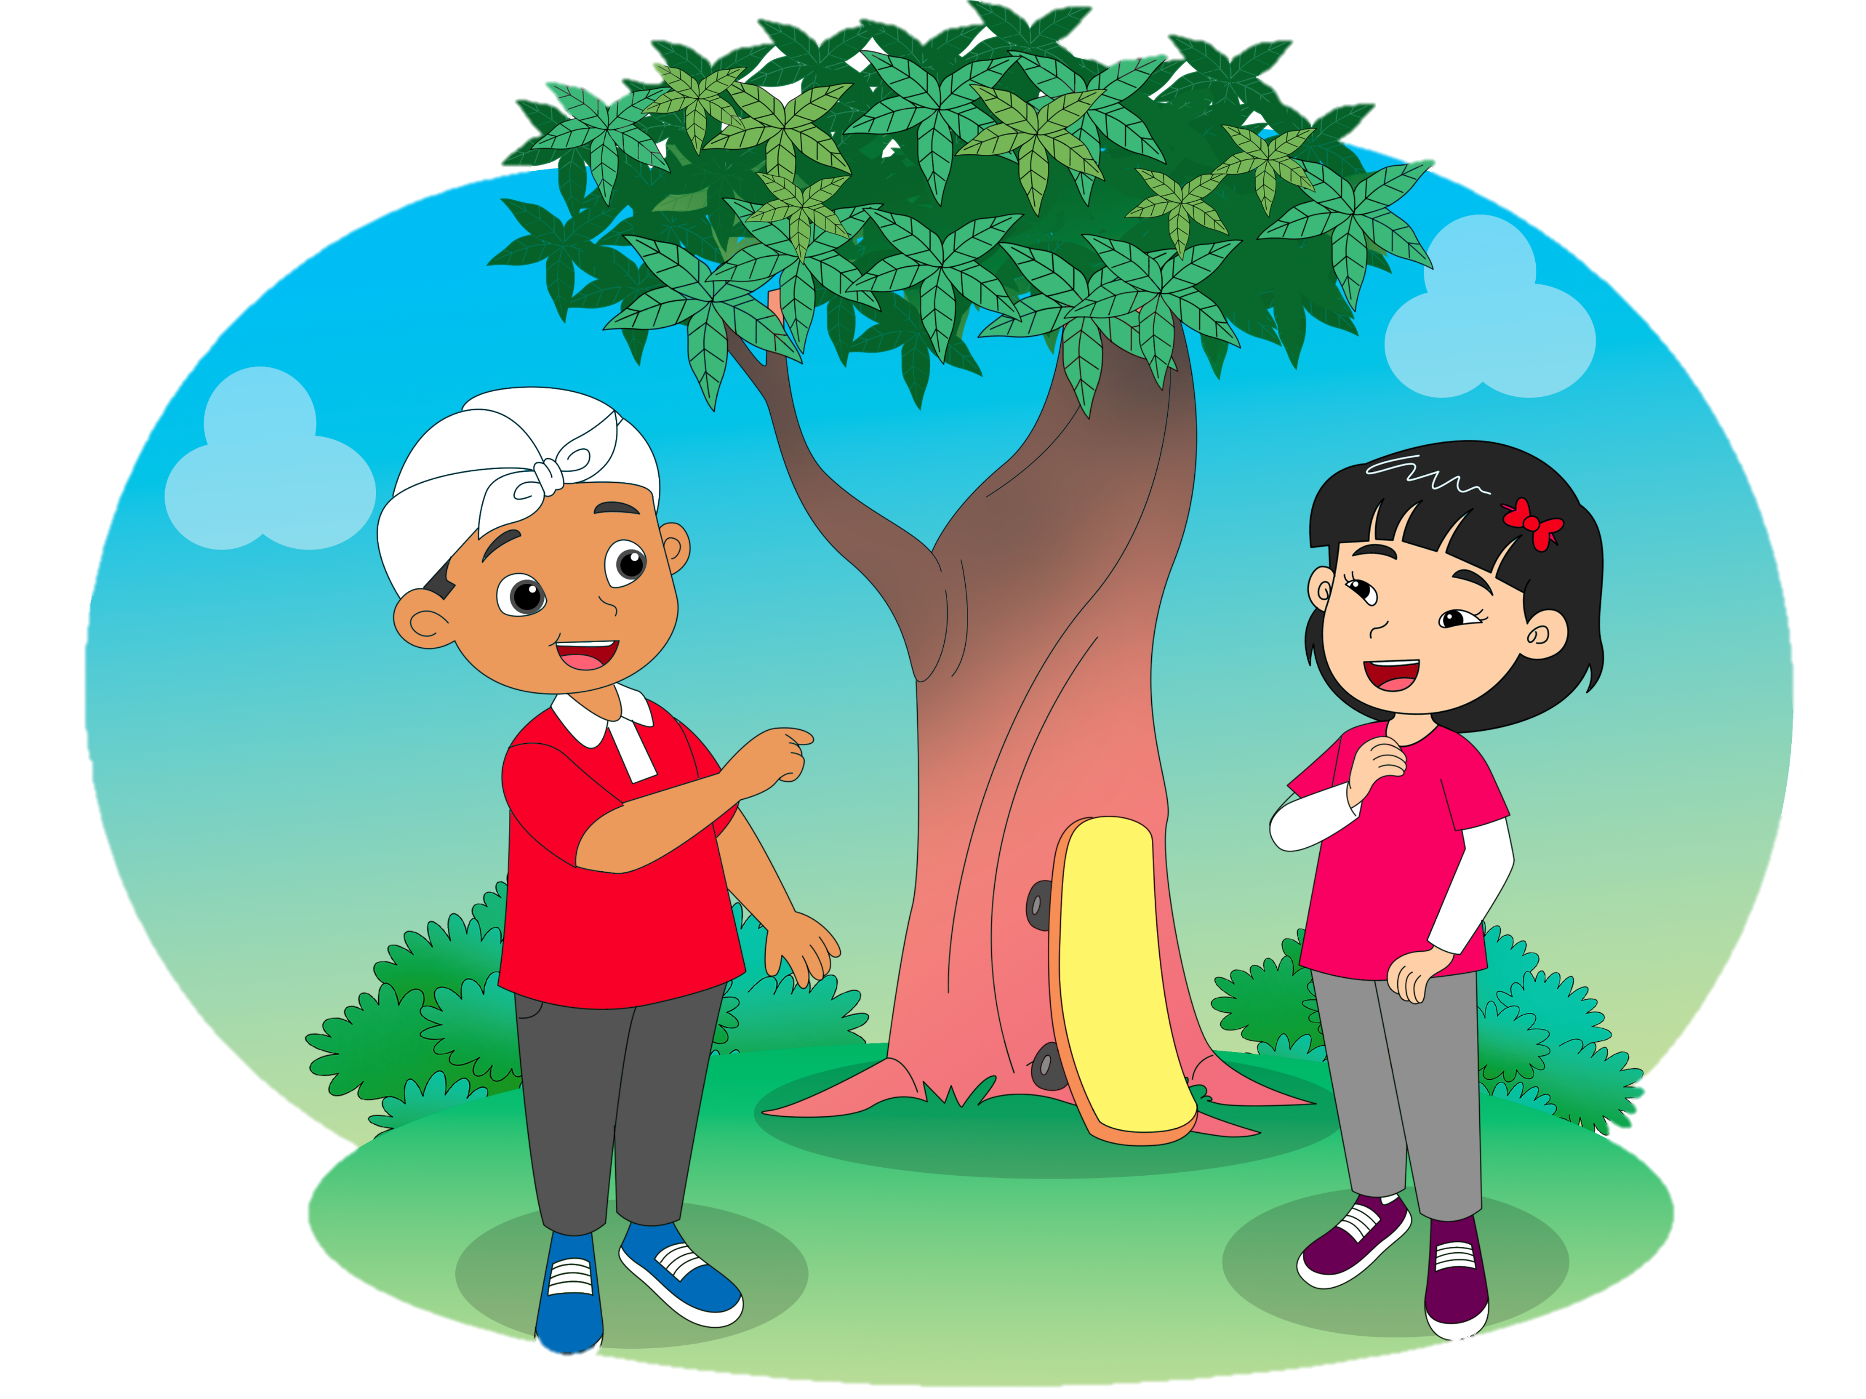
Whose Skateboard
Is This?
7.
Ask and tell about possession
Ask for confirmation
Theme: Toys (Possession)

Slide 2
D.
Listen and do.
Fly the kite.
Arrange the Lego blocks.

Slide 3
D.
Listen and do.
Play the spin top.
Ride the skateboard.

Slide 4

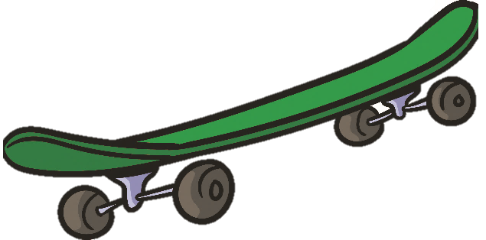
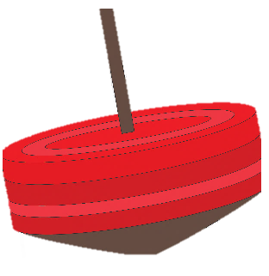
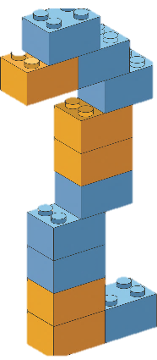
E.
Say a chant.
Toys
Spin top, skateboard
Lego blocks, Lego blocks,
Spin top, yoyo, toy car, too
Red spin top
Green skateboard
Colorful Lego blocks
Orange and blue

Slide 5
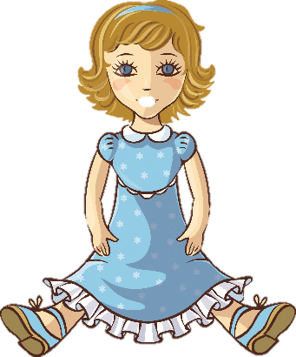


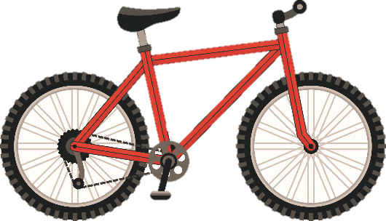
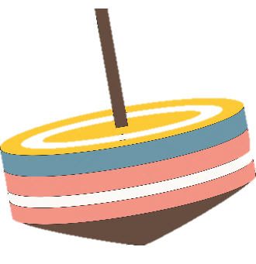
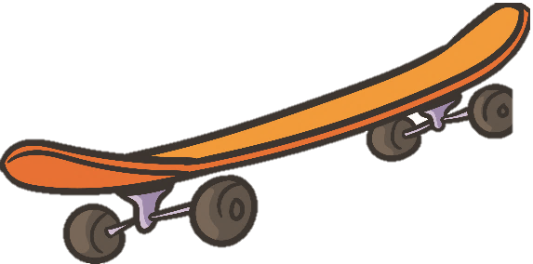
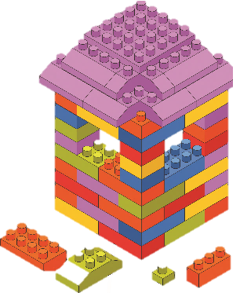
G.
View and sing.
My Toys
My kite, my doll
My skateboard, my ball
My kite, my doll
My spin top, my bike
My kite, my doll
My yoyo, my blocks
Let’s play with the toys together

Slide 6
I.
Play a game.
It’s Tigor’s kite, isn’t it?
Yes, it is.

Slide 7
K.
Read for fun.
Meilin is sitting on the floor in her room. She is spending her free time after an online class. She has 15 minutes to play with her toys. She is playing blocks. She is now building a small house with the blocks. She needs some more time to finish the house. Actually, the block are not Meilin’s. They are her brother’s.

