Slide 1
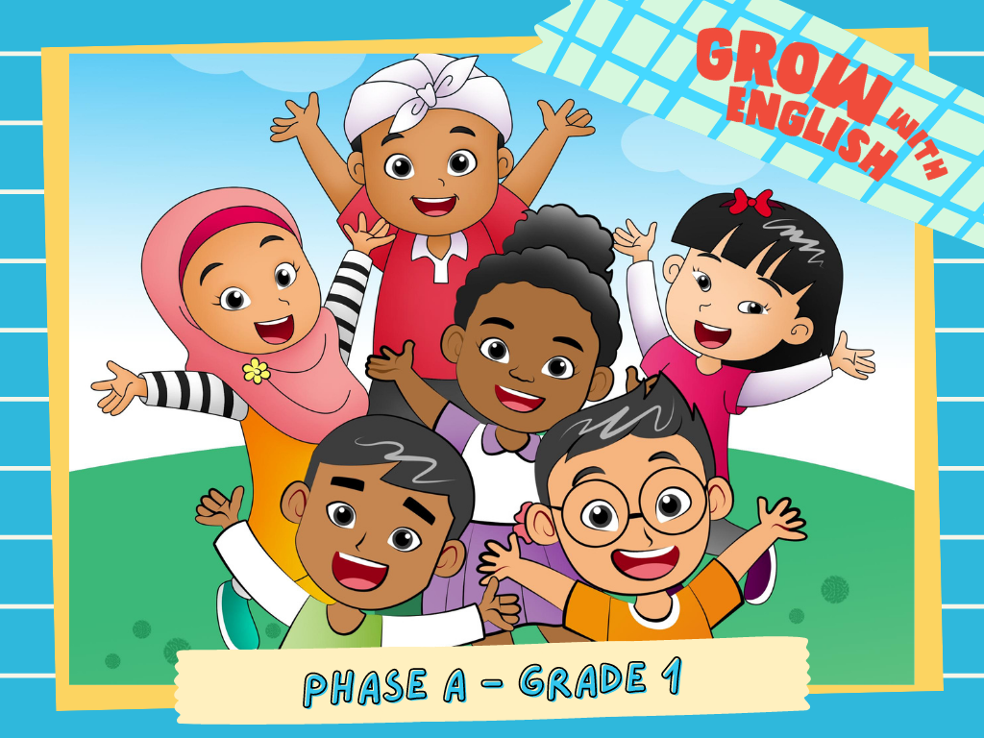

Slide 2
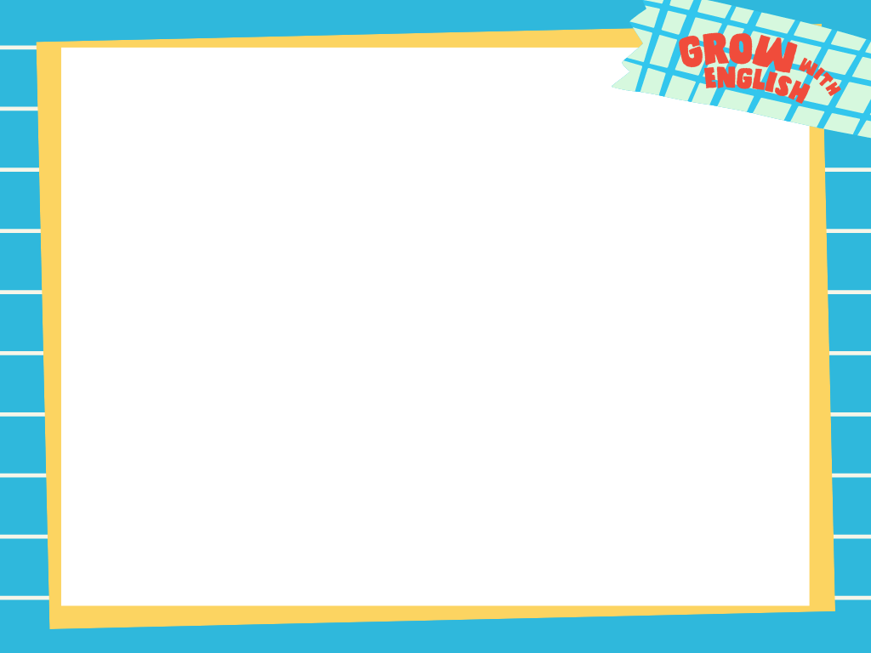
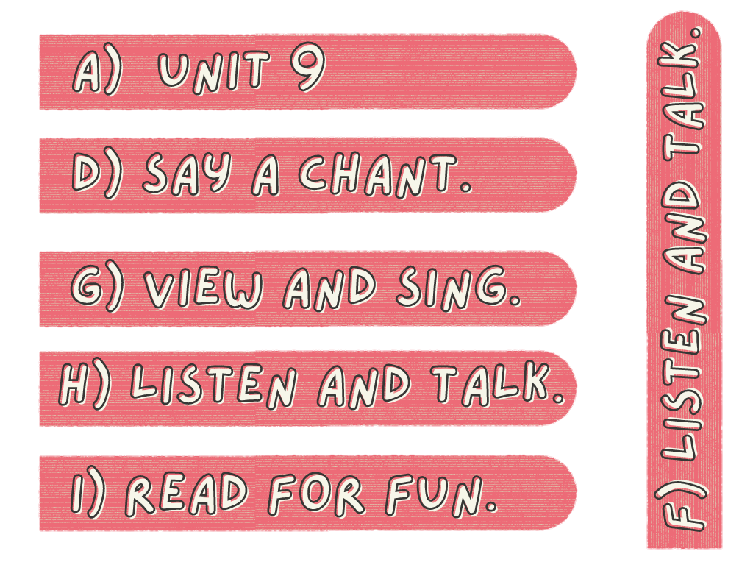
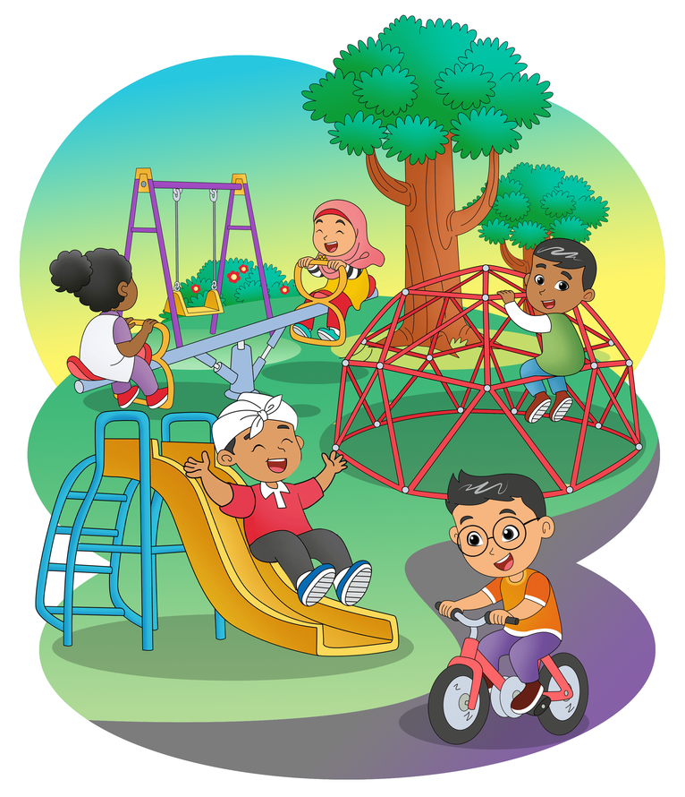
Playground
What do you in the playground?

Slide 3
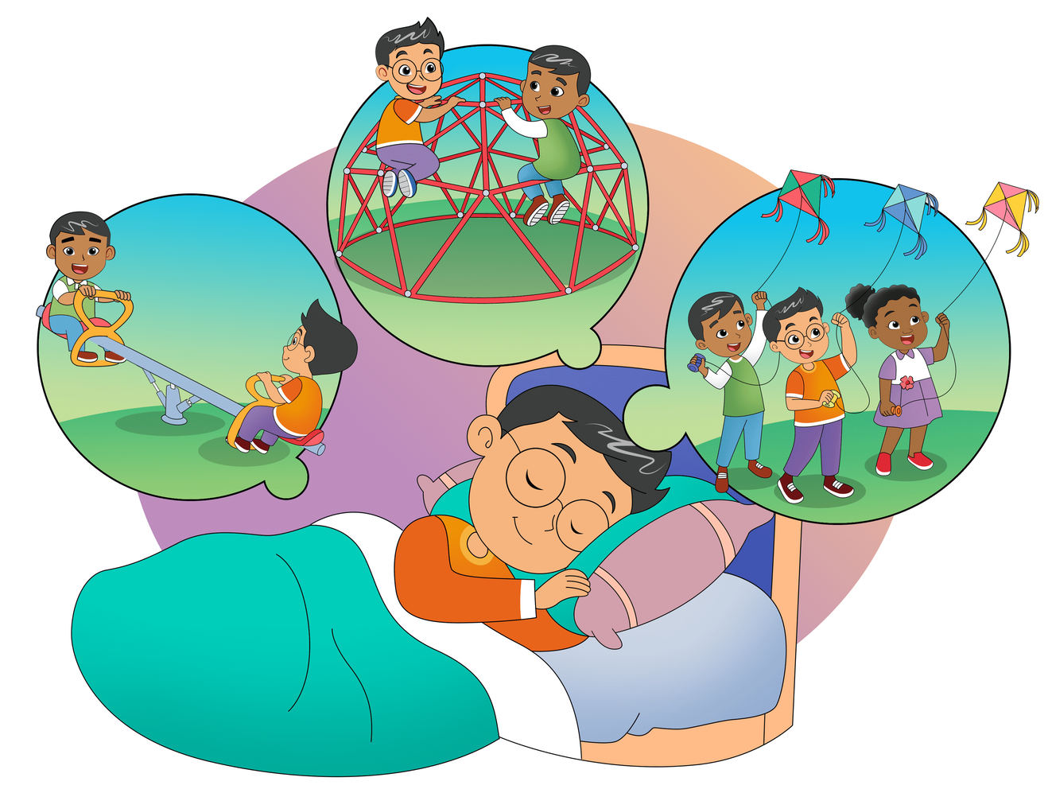
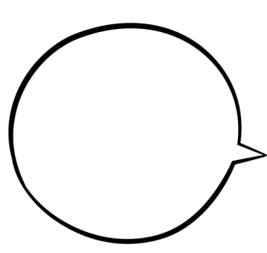

Ride
a see-saw
Ride
a see-saw

Slide 4

Climb a
jungle gym

Slide 5

Fly a big kite,
fly a big kite

Slide 6

With
my friends,
I dream

Slide 7

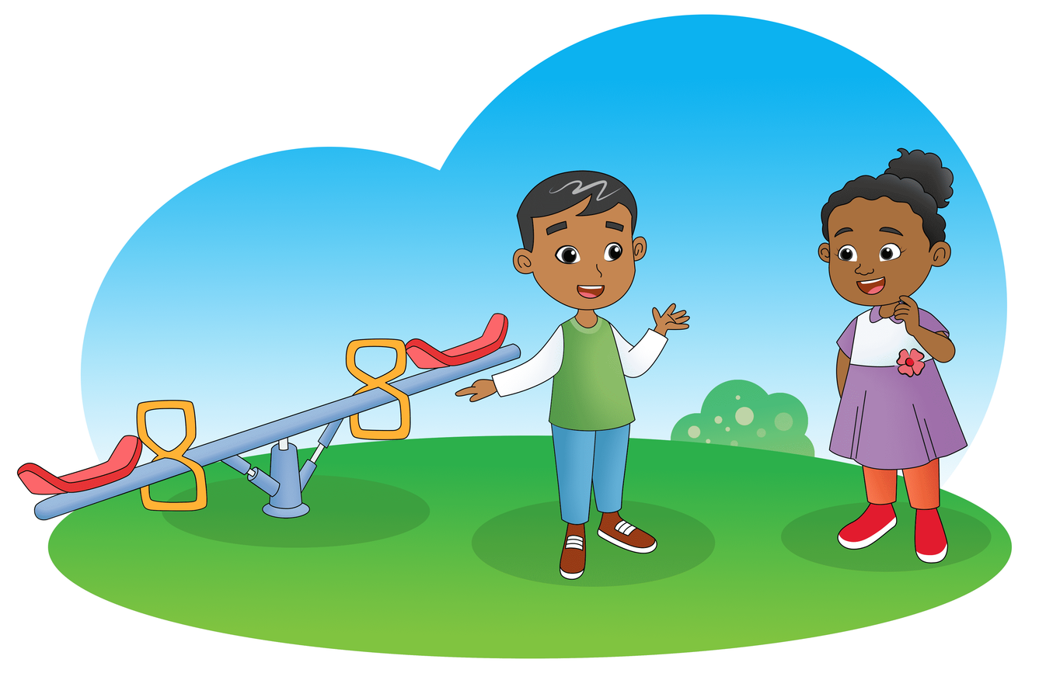

Let's ride
the see-saw.
Okay.

Slide 8
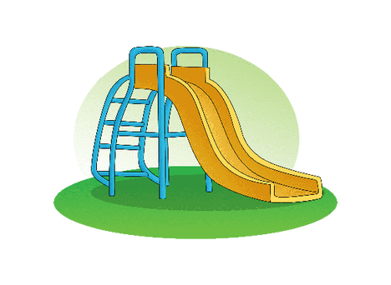
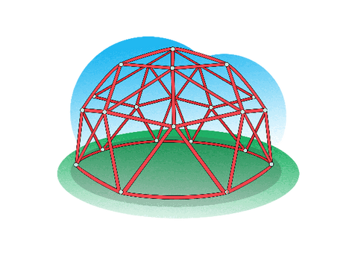
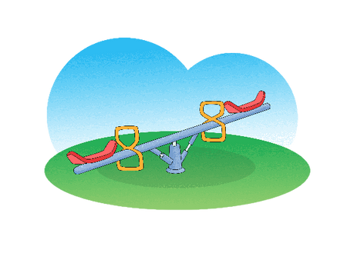

Slide 9
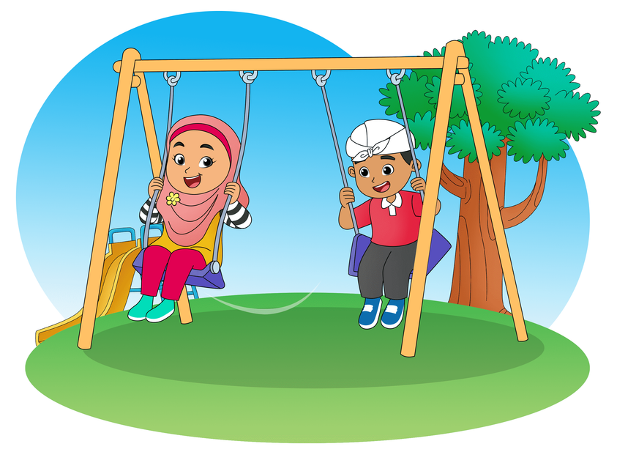
Swing Up High
Swing, swing, swing up high.
Swing, swing, swing up high.
Swing, swing, swing up high.
Swing up to the sky.

Slide 10
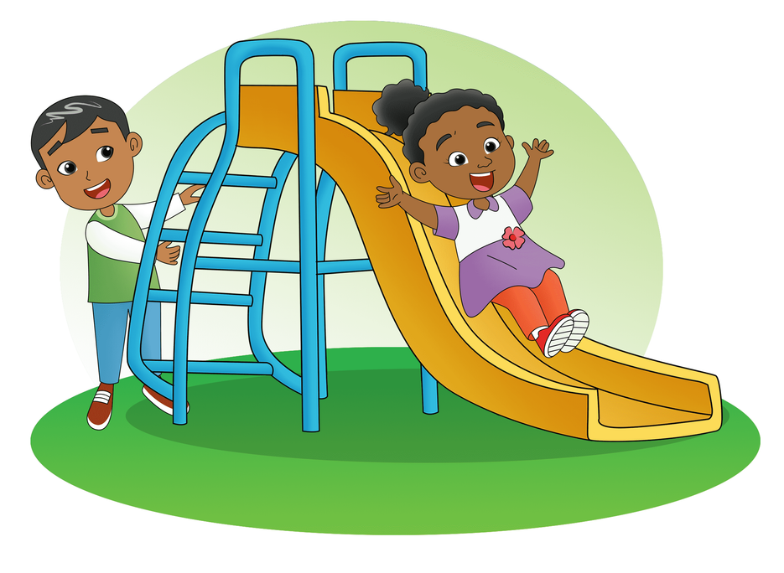
Swing Up High
Slide, slide, slide down low.
Slide, slide, slide down low.
Slide, slide, slide down low.
Slide down to the ground.

Slide 11
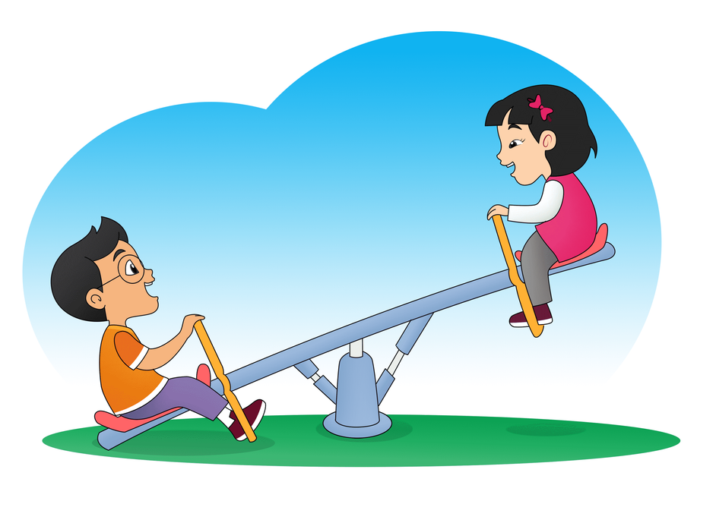
Swing Up High
Ride, ride, ride the see-saw.
Ride, ride, ride the see-saw.
Ride, ride, ride the see-saw.
Ride it up and down.

Slide 12
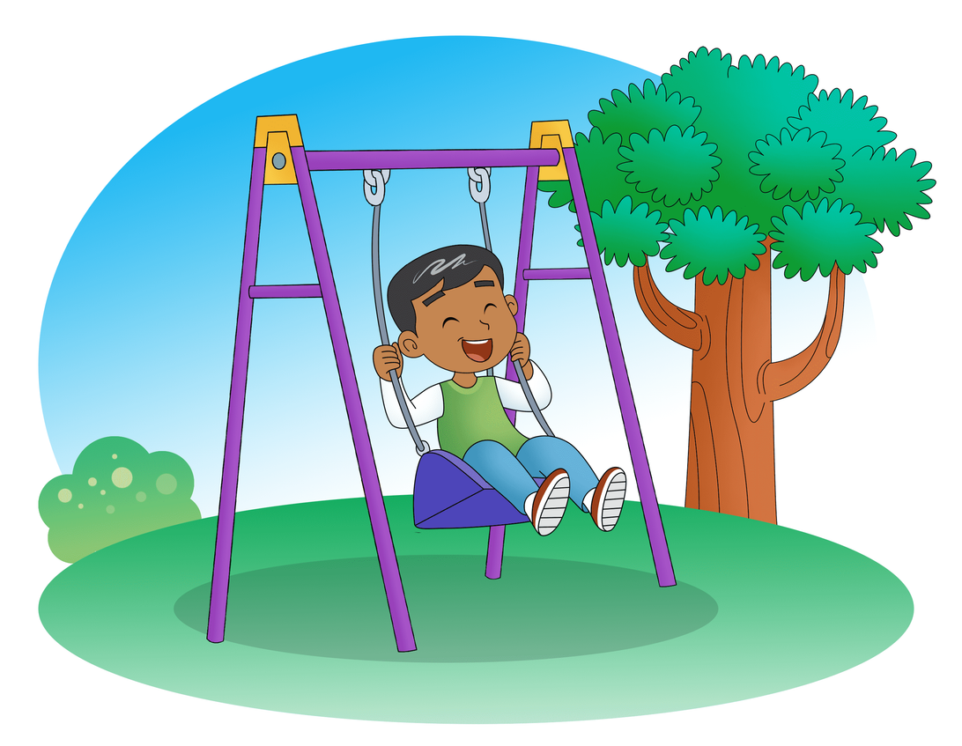
Look.
I am playing
on the swing.

Slide 13
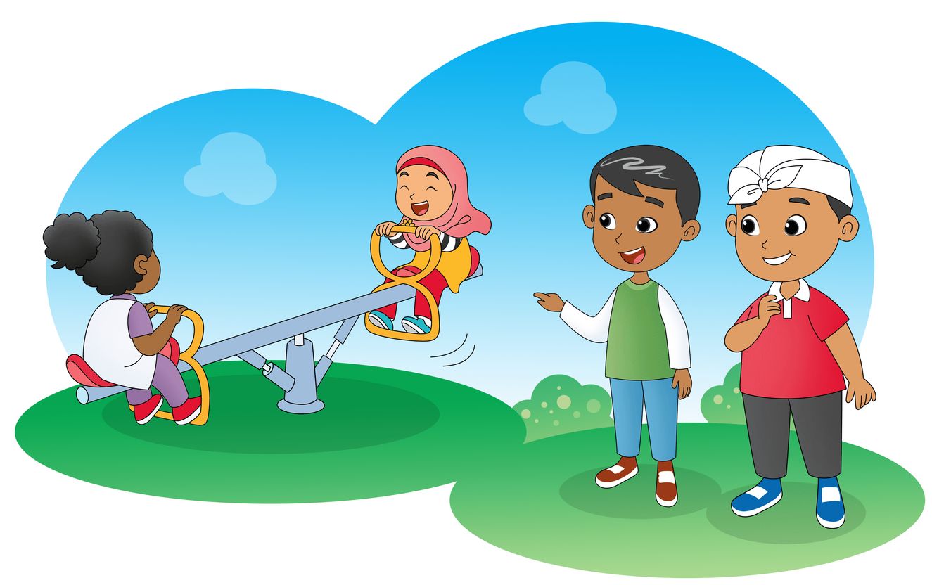
Look.
Nurul and Dona
are riding
a see-saw.
Yes.
They are riding
the see-saw.

Slide 14
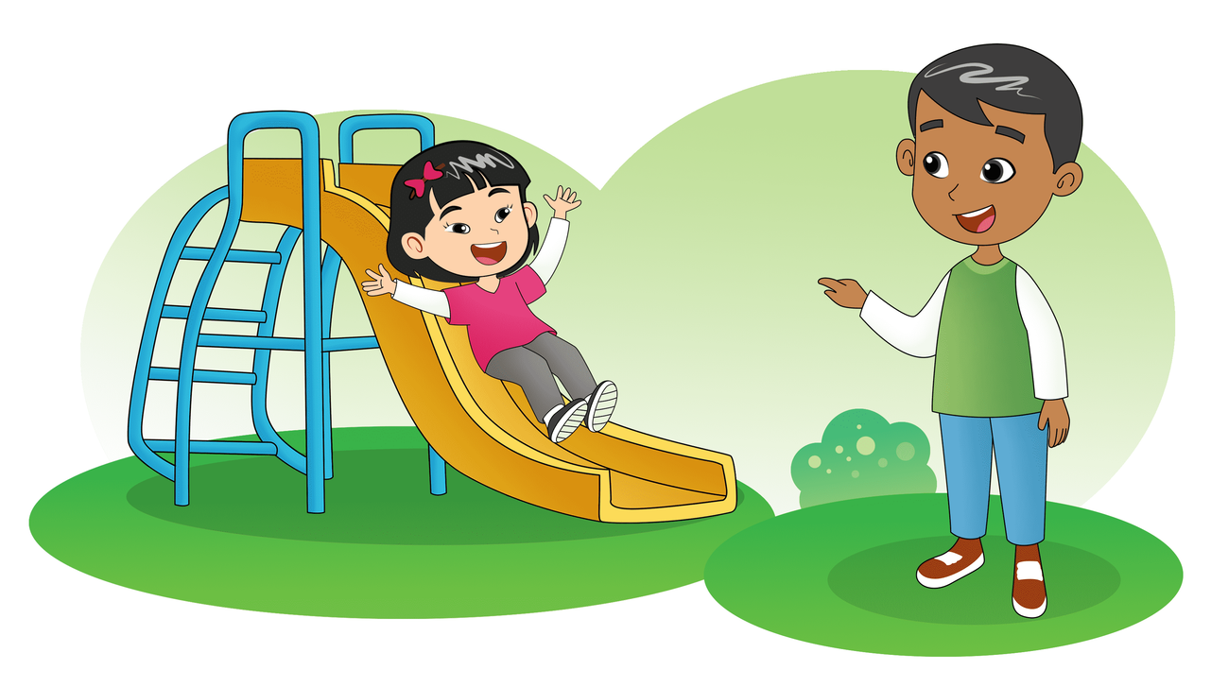
Look.
Meilin is playing
on the slide.

Slide 15
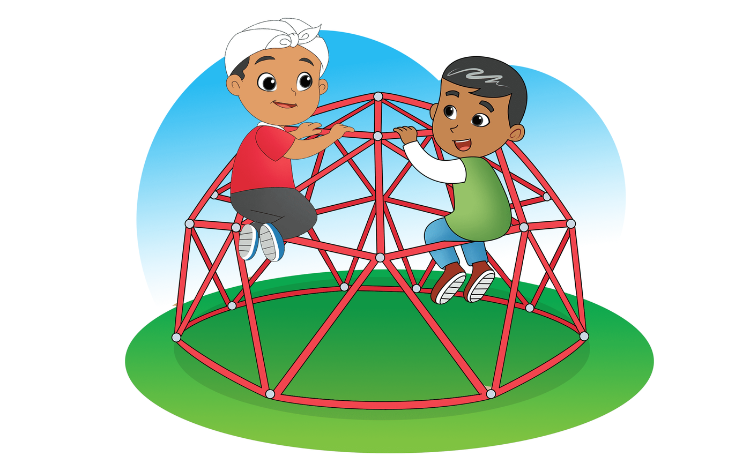

Look.
Tigor and I
are climbing
the jungle gym.
Yes. We are
climbing the
jungle gym.

Slide 16
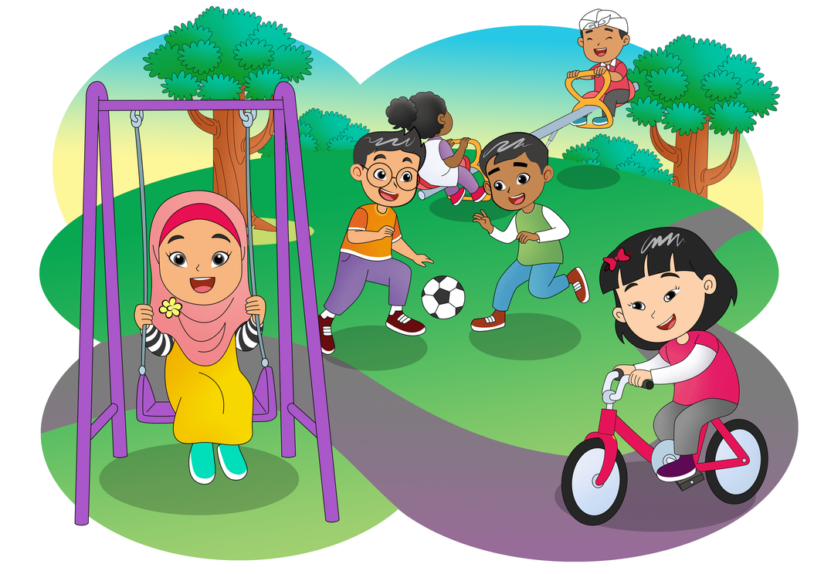
At the Playground
Hi, I am Nurul.
Look, we are at the playground.
I am playing on the swing.
Meilin is riding her red bike.
Tigor and Seta are playing football.
Dona and Made are riding the see-saw.
We are having a good time.
Cheers!

