Slide 1


Slide 2

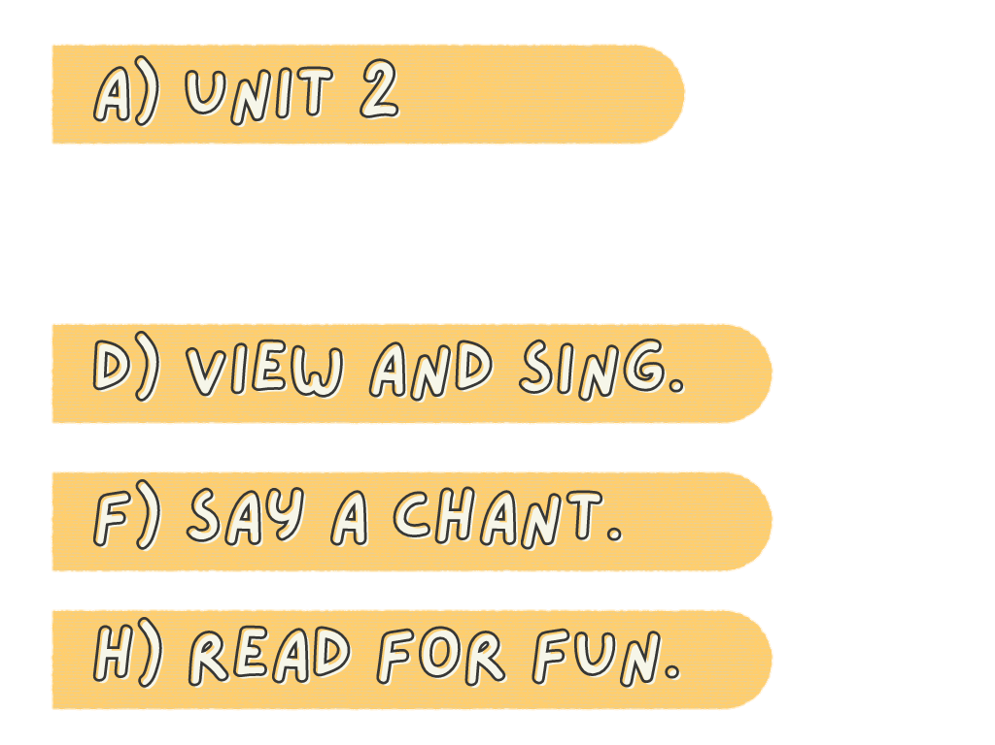
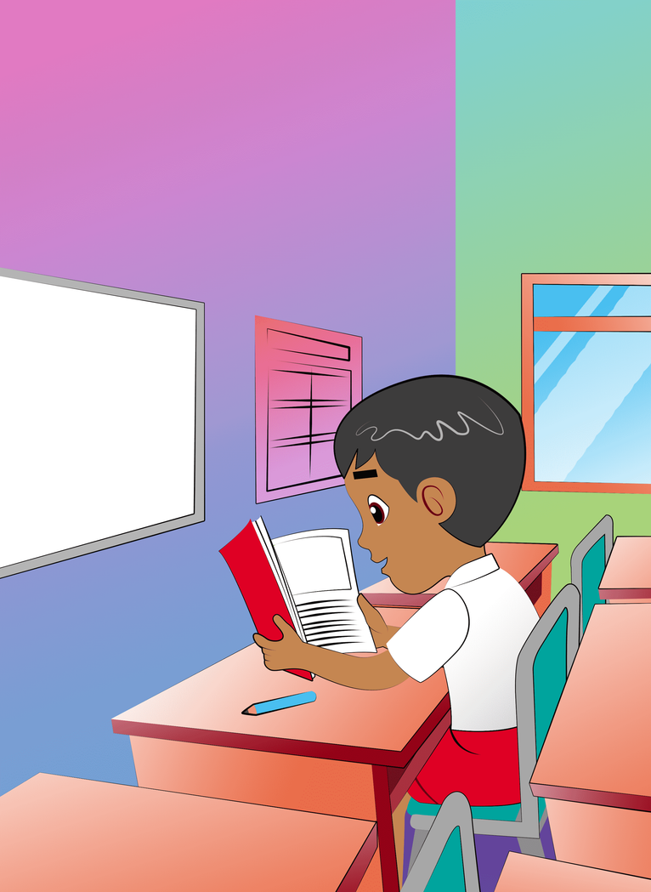
My Classroom
Describe
your classroom!

Slide 3
Will You Show Me a Pencil
Will you show me a pencil,
a pencil, a pencil?
Will you show me a pencil,
which is in the class?
'Cause I need a pencil,
a pencil, a pencil.
Will you show me a pencil,
which is in the class?

Slide 4

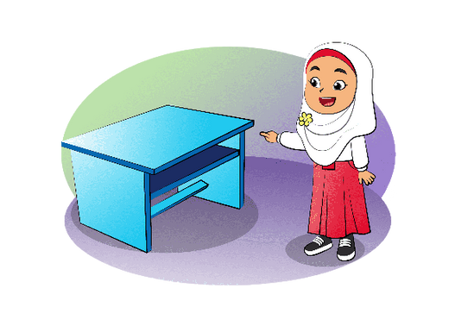
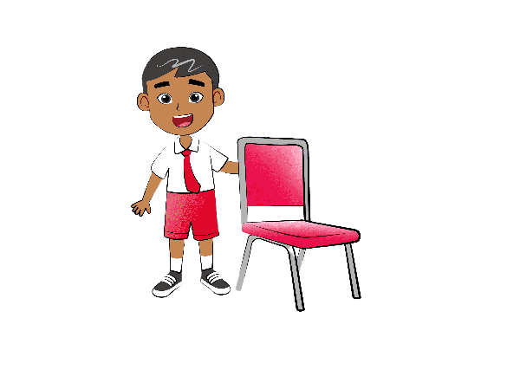

red chair
blue desk

Slide 5

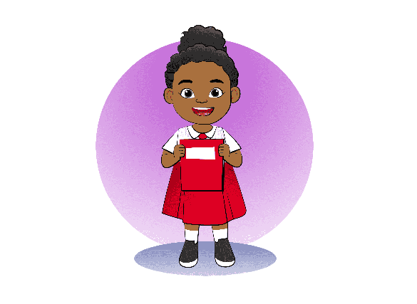
red book
blue bag

Slide 6
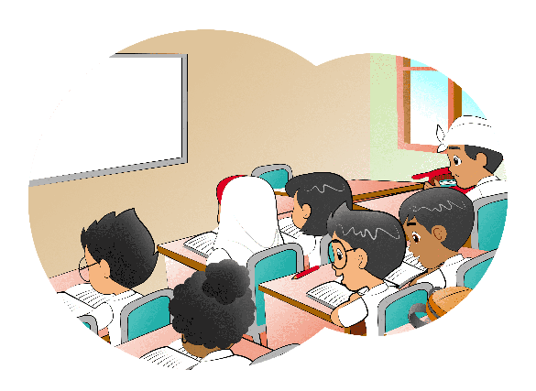
in
my class

Slide 7
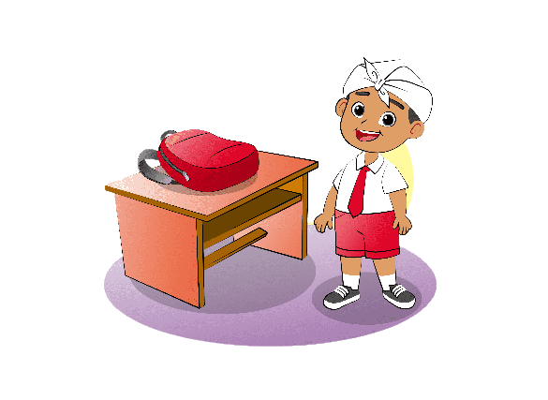
My Red Bag
Look. It's my red bag.
Inside it, I have a red pencil.
There is also a red book.
Red is my favorite color.

