Slide 1
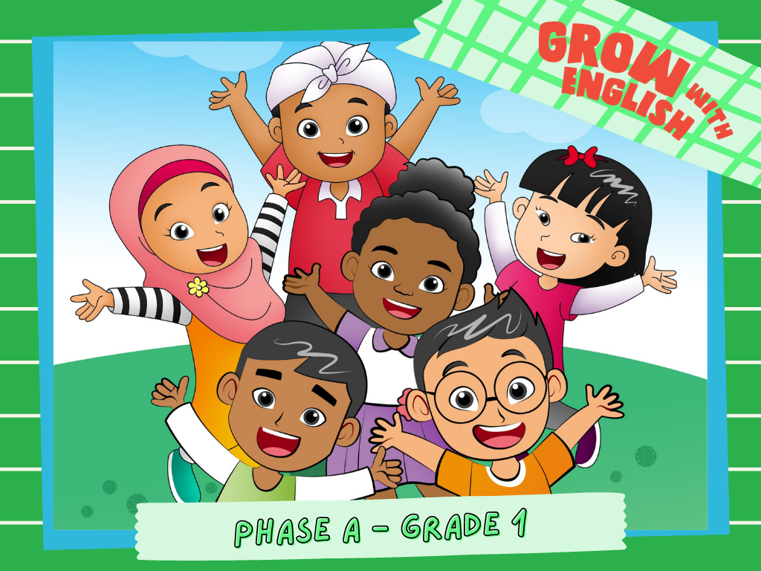

Slide 2

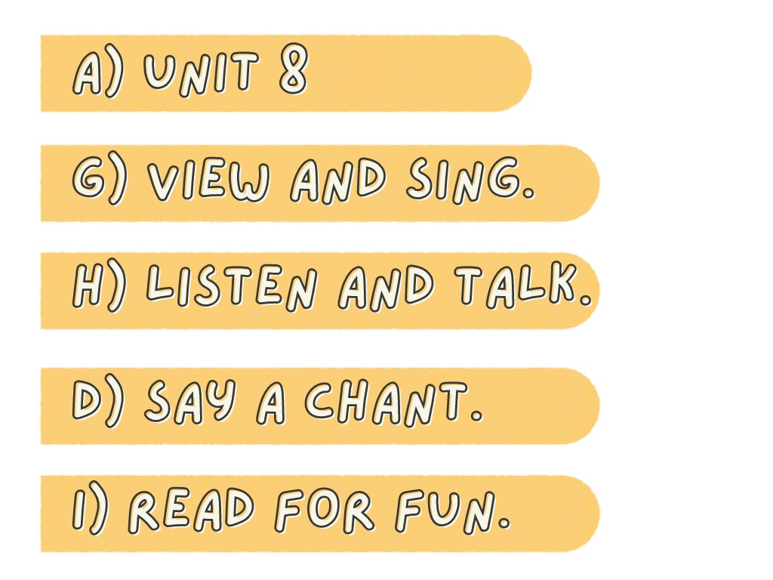
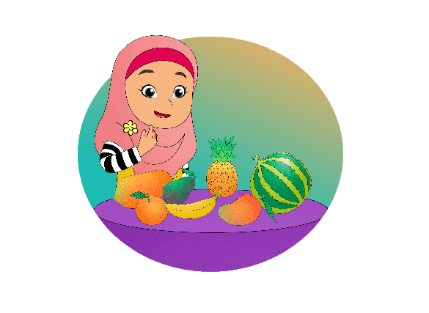
Fruit
What fruit do you like?
What fruit do you dislike?

Slide 3

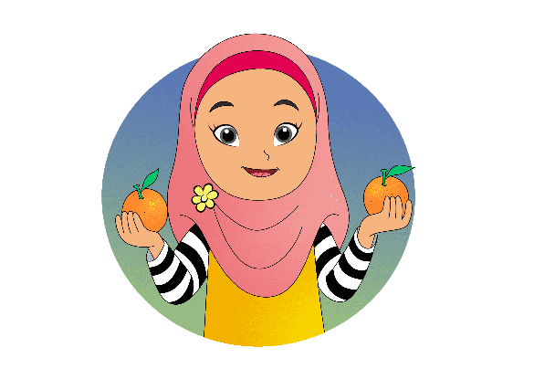
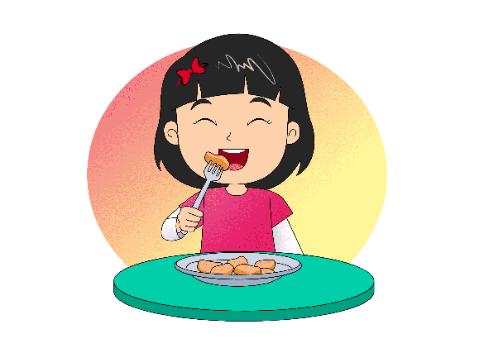
What fruit
do you like?
I like
oranges.

Slide 4
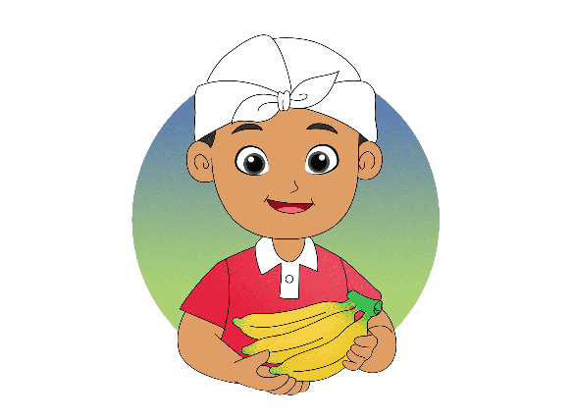
What fruit
do you like?
I like
bananas.

Slide 5
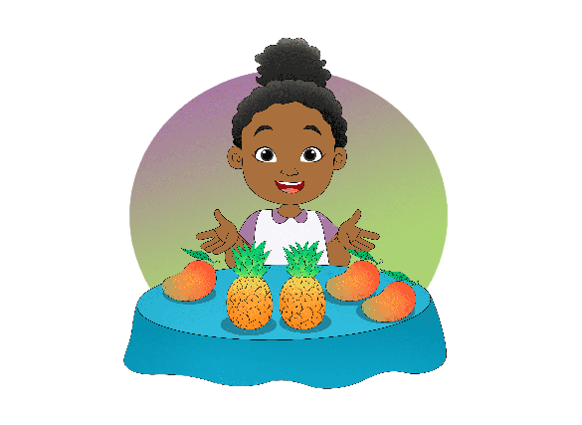
What fruit
do you like?
I like pineapples,
and I like
mangoes too.

Slide 6
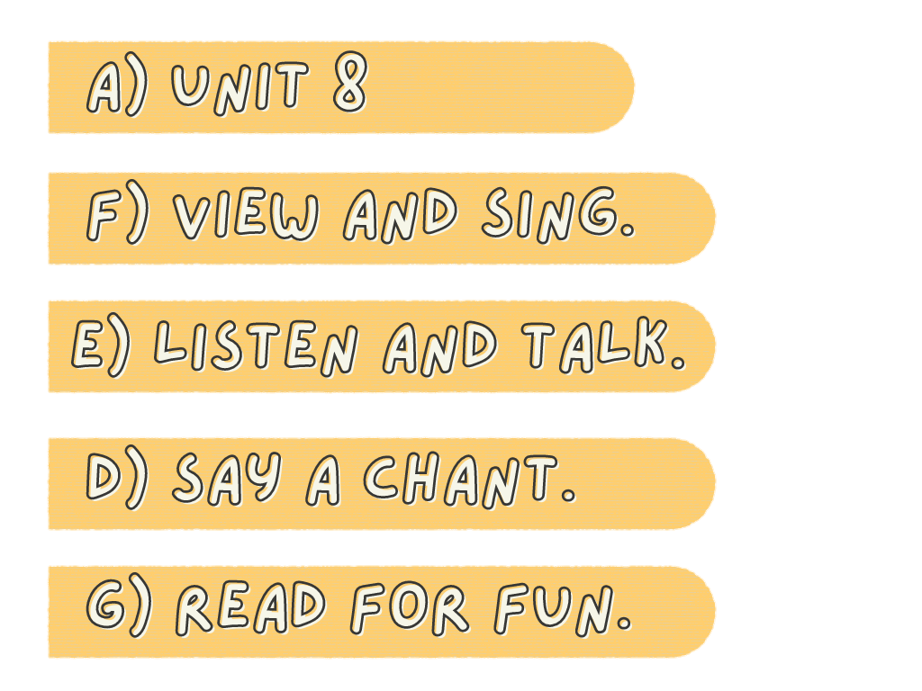
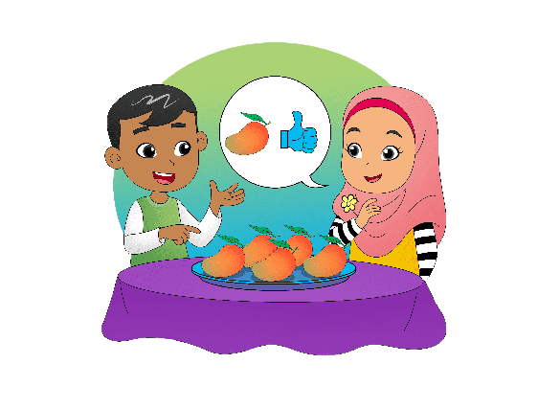
Do you like
mangoes?
Yes, I do.

Slide 7
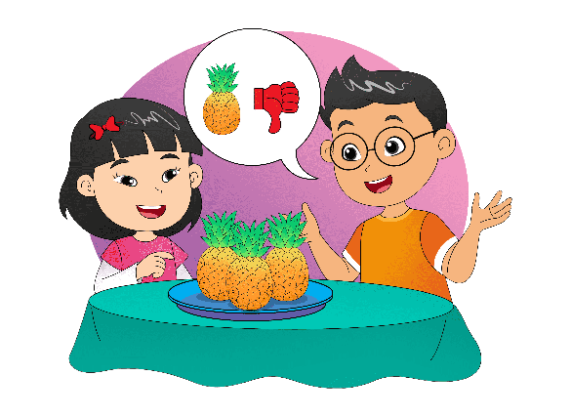
Do you like
pineapples?
No, I don't.

Slide 8

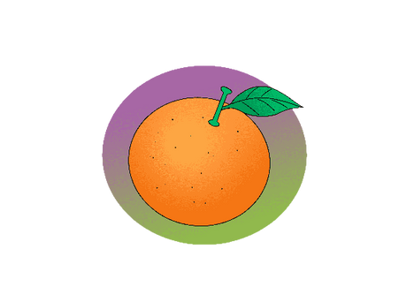

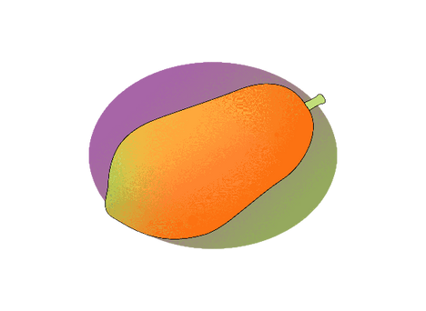
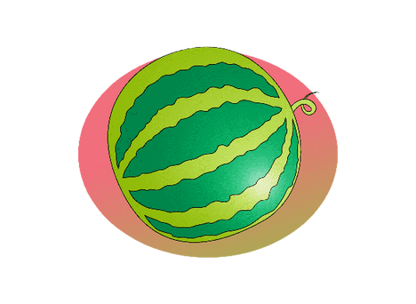


Slide 9
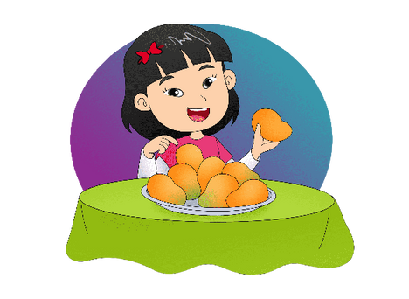
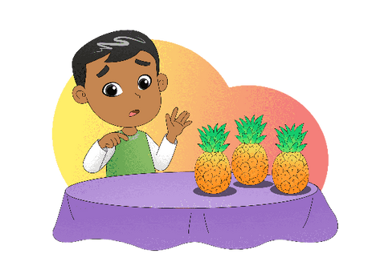
I like mangoes,
I like mangoes
Yup yup yup,
yup yup yup.
I don't like pineapples,
I don't like pineapples.
No no no
No no no

Slide 10
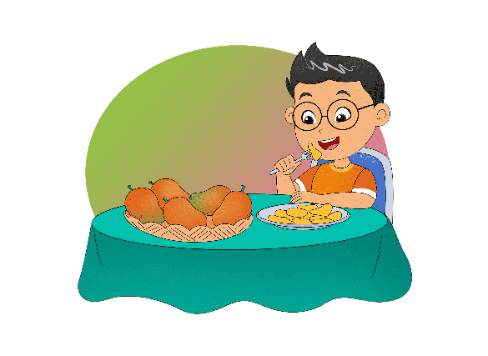
I like mangoes.
Mango is my favorite fruit.
I like avocados.
Avocado is my favorite fruit too.

