Slide 1
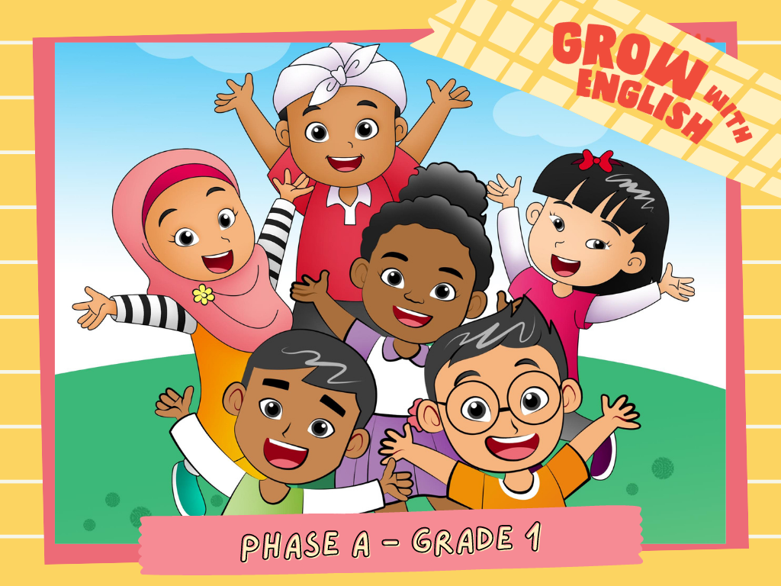

Slide 2

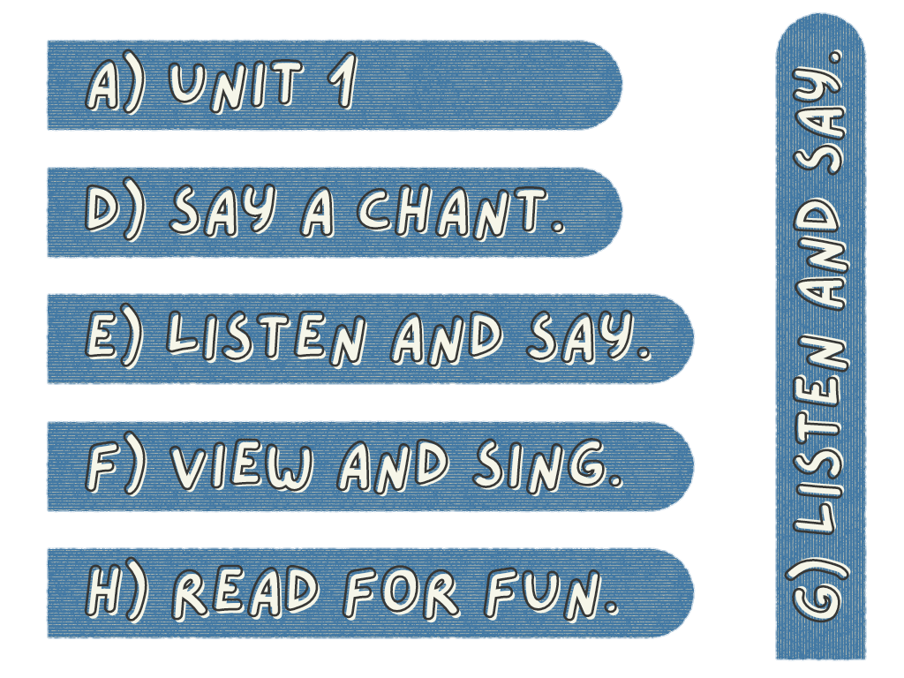
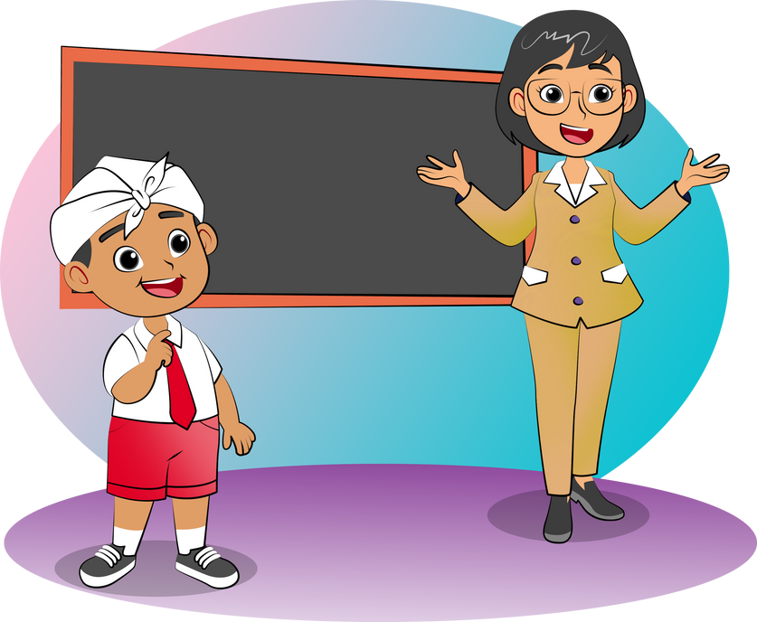
My Friends and Teacher.
Greet your
teacher and friends!

Slide 3

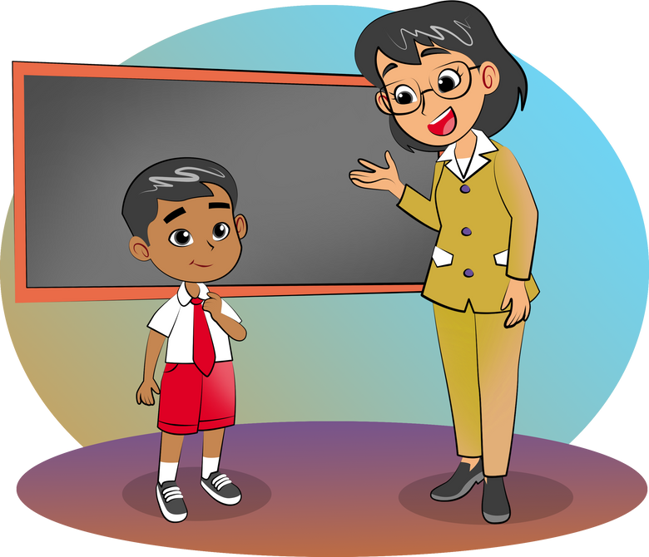
Hello
Tigor.
Hello,
Ms. Betha.
I'm fine.
Thank you.
How
are you?

Slide 4
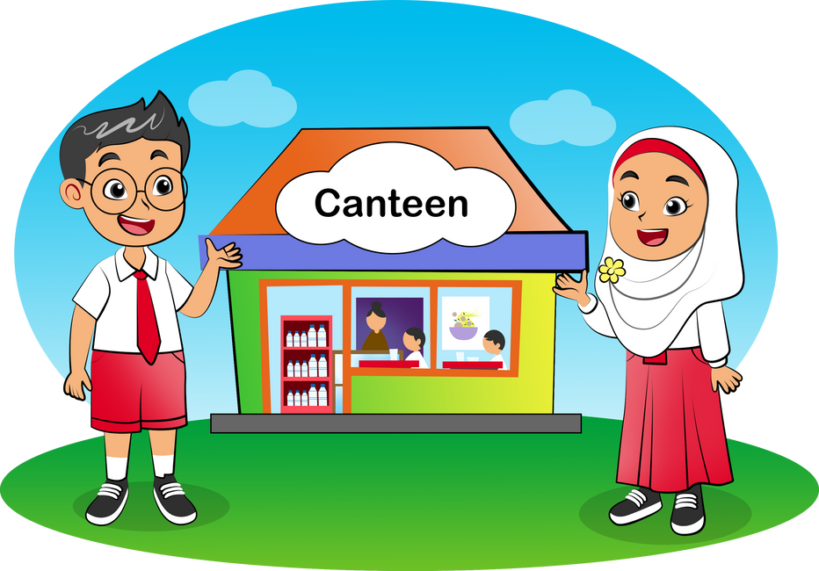
Hello,
Nurul.
Hello
Seta.
How
are you?
I'm fine.
Thank you.

Slide 5
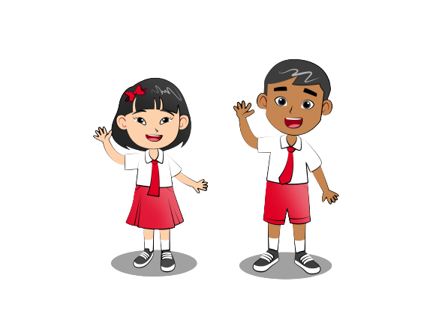
Hello How Are You
Hello. Hello. How are you?
Fine, thanks. Fine, thanks.
How are you?
Hello. Hello. How are you?
I'm fine. Thank you.

Slide 6
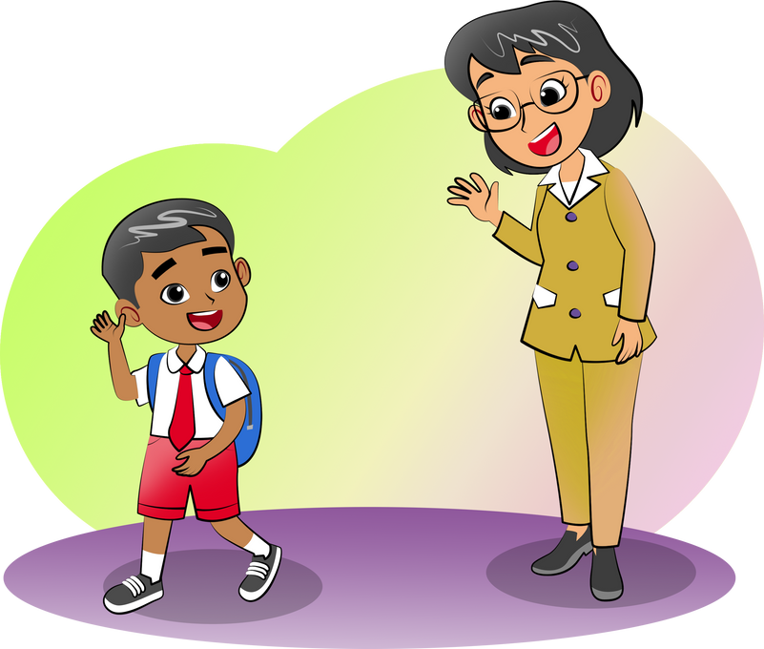
Goodbye,
Tigor.
Goodbye,
Miss Betha.

Slide 7
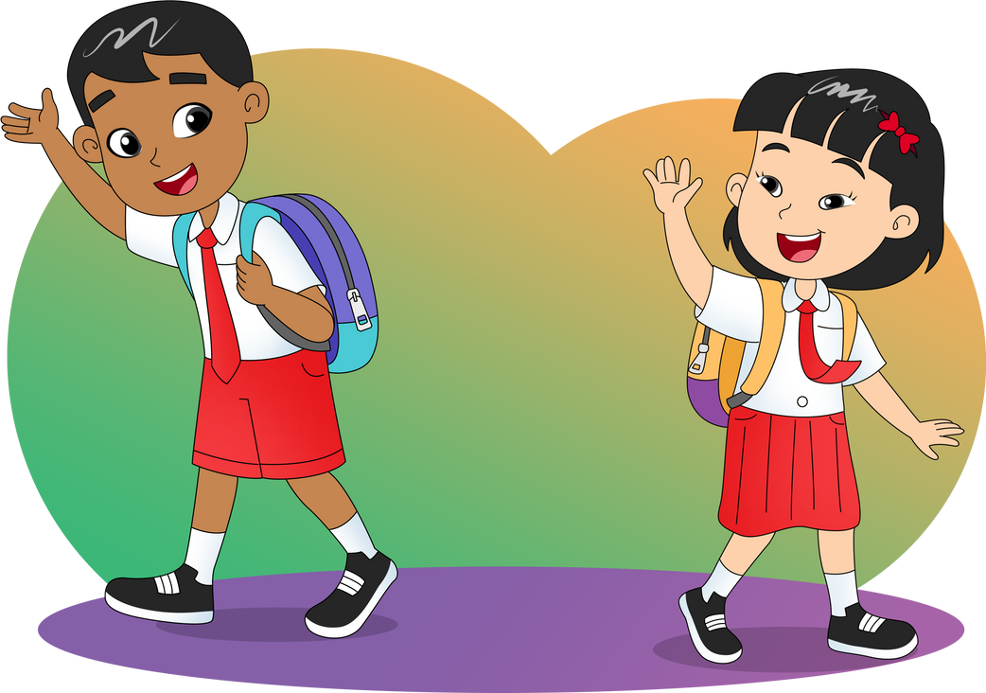
Goodbye,
Meilin.
Goodbye,
Tigor.

