Slide 1
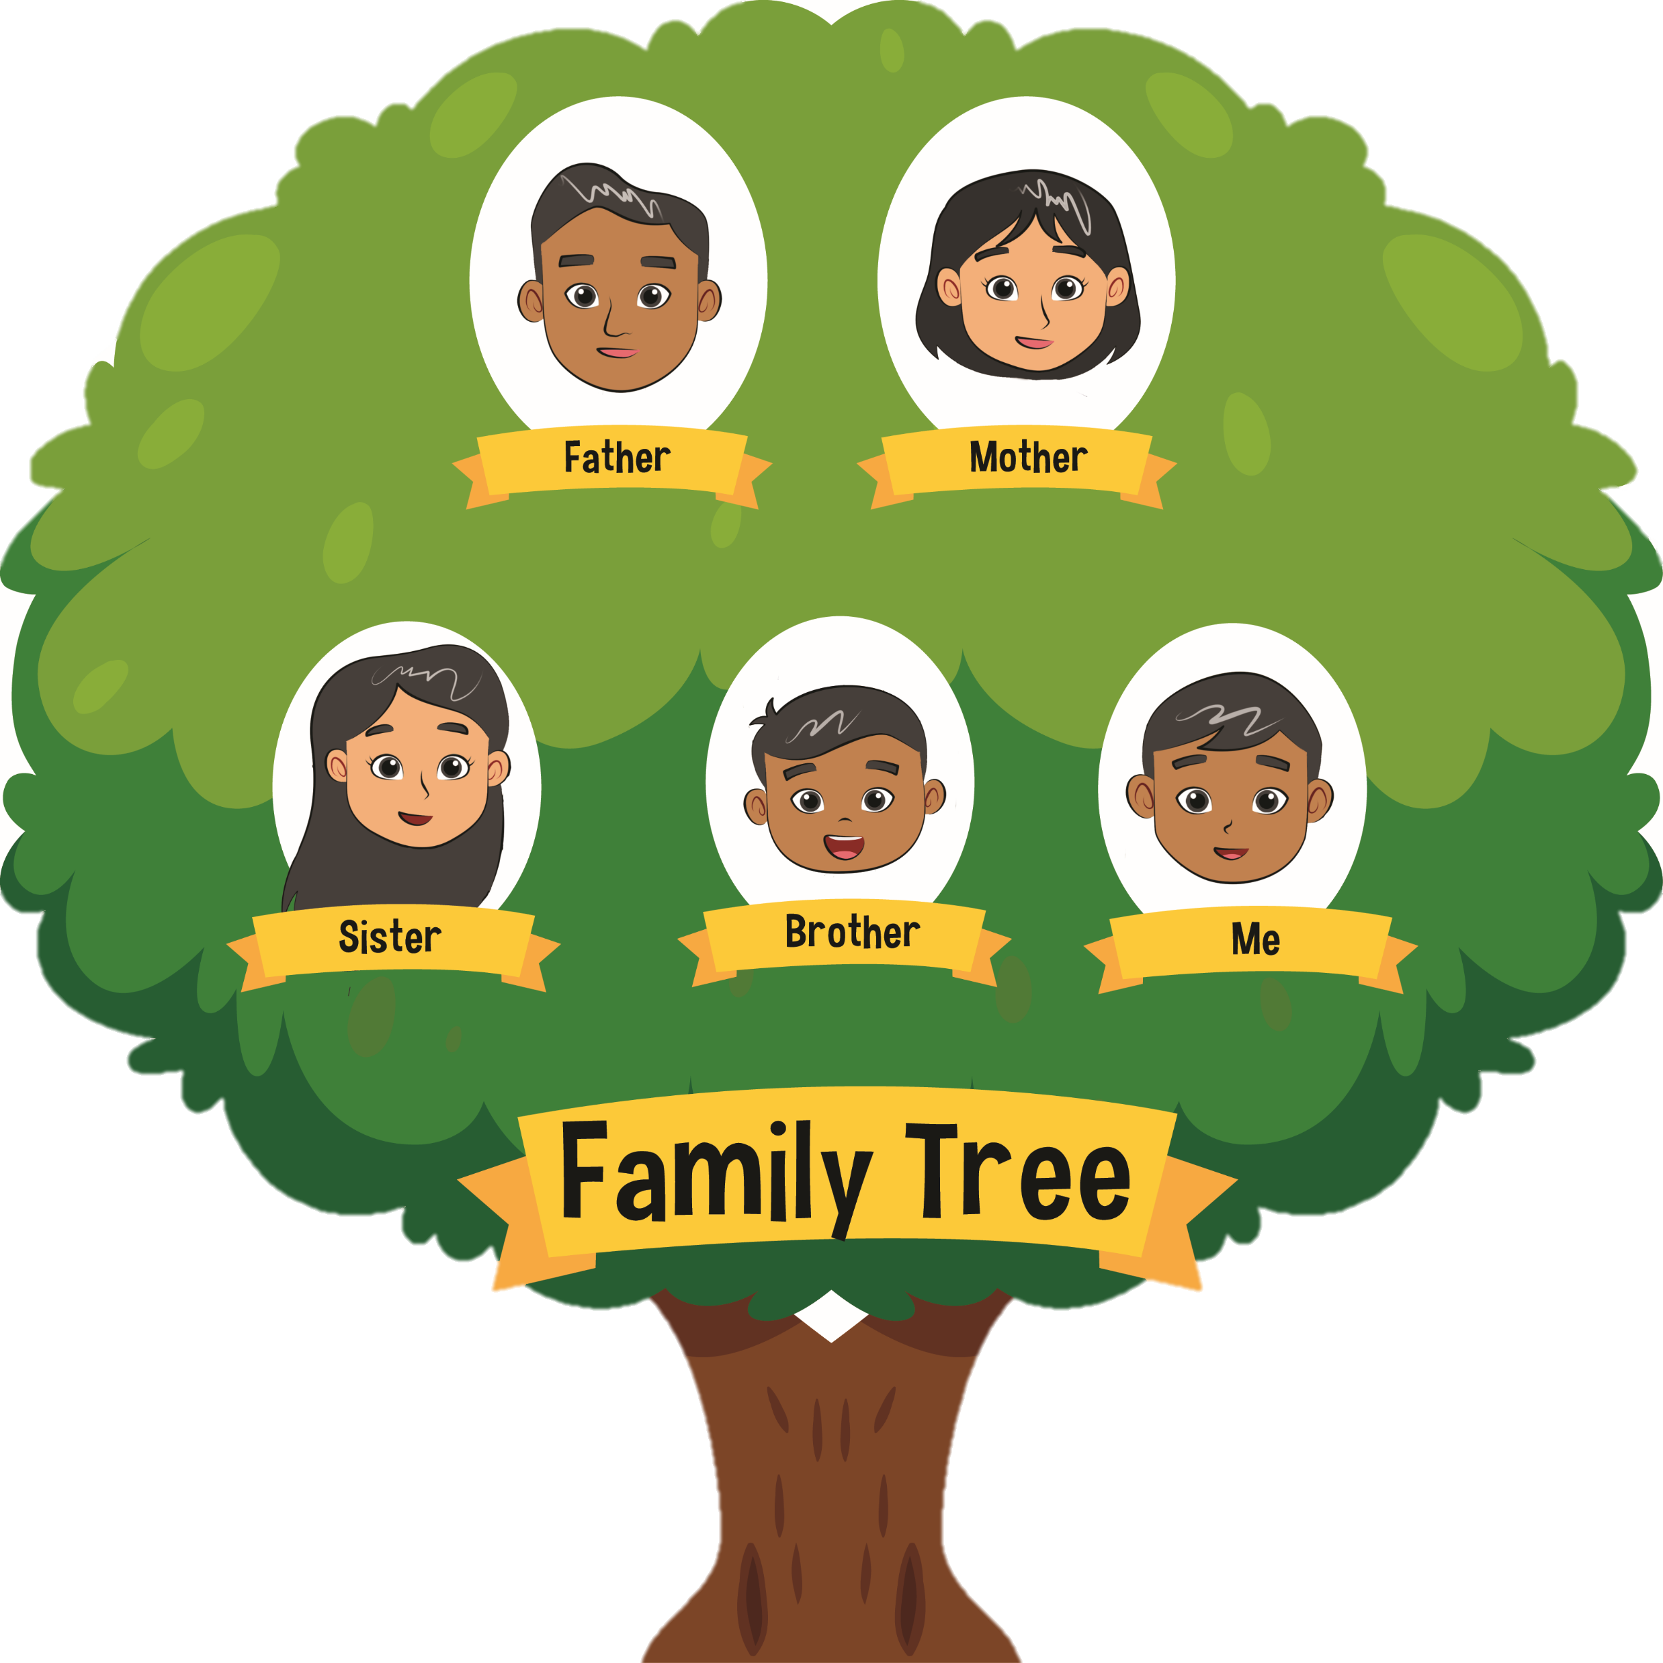
This Is My Family Tree
5.
Identify activities
Ask and tell about activities
Describe family
Theme: My Big Family’s Picnics

Slide 2
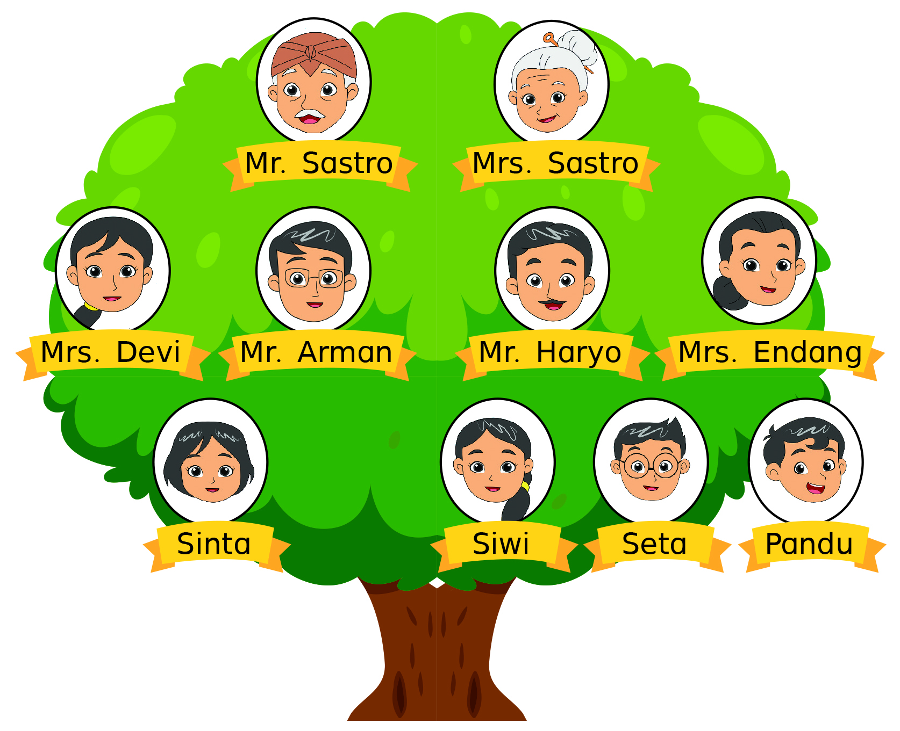
D.
Look and say.

Slide 3
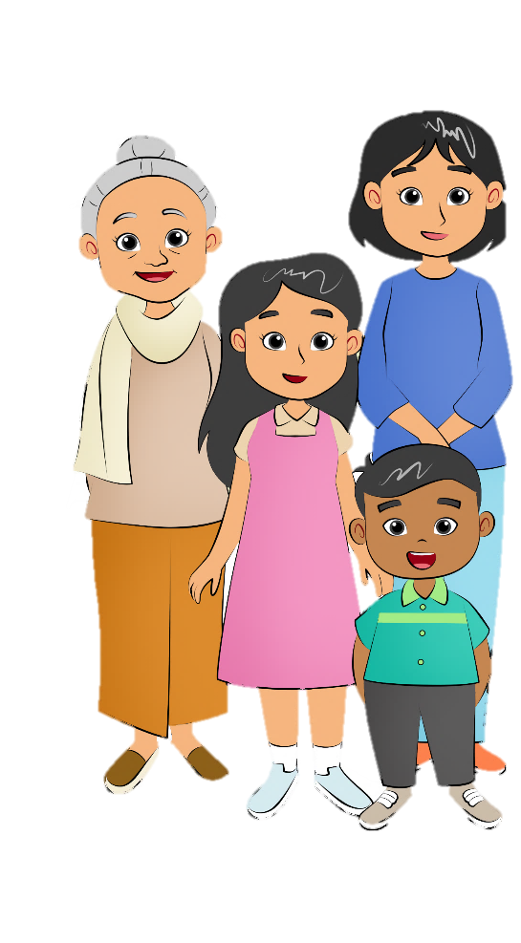
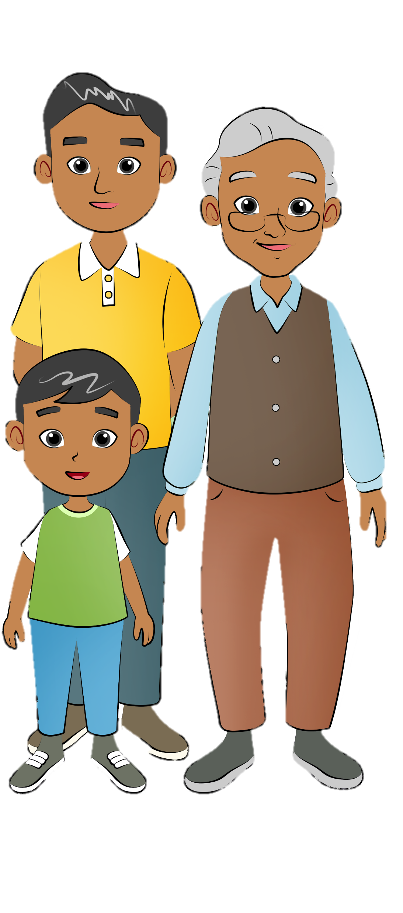
F.
Say a chant.
Family Chant
Who is in the family?
Hmmm. Let me see.
There is a mother.
There is a father.
There is a daughter and a son, too.
Who is in the family?
Hmmm. Let me see.
There is a grandpa.
There is a grandma.
There is a cousin, uncle, and aunt.

Slide 4
G.
Listen and do.
Collect sea shells.
Build a sandcastle.

Slide 5
G.
Listen and do.
Play beach football.
Drink coconut water.

Slide 6
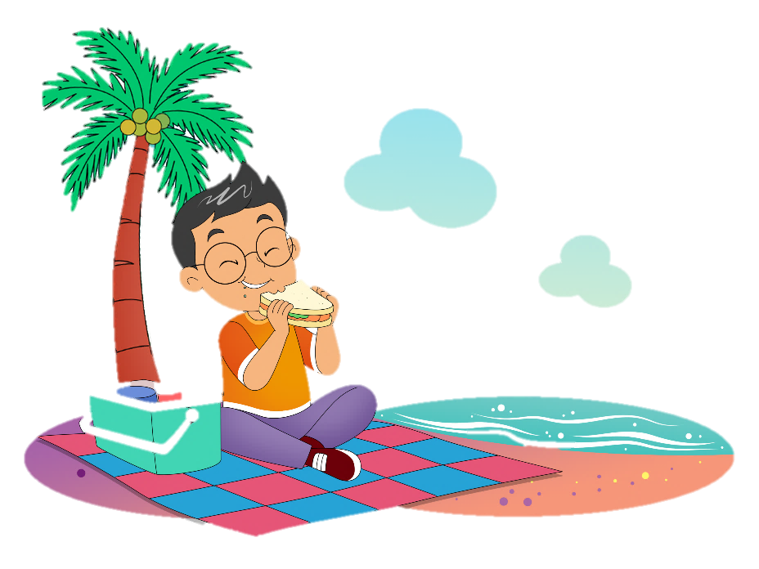
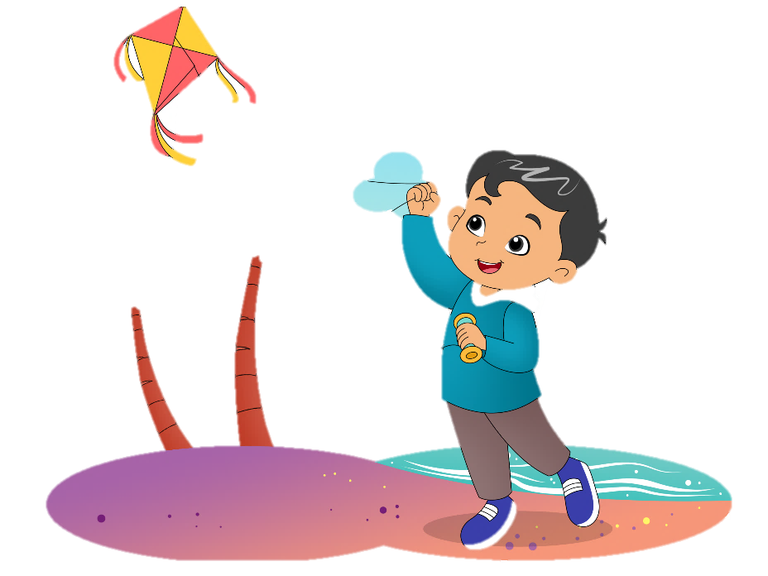
I.
View and sing.
Seta’s Having a Picnic
Seta’s having a picnic,
picnic, picnic
Seta’s having a picnic
all day long.
Pandu’s flying a kite,
a kite, a kite
Pandu’s flying a kite
all day long.

Slide 7
K.
Play a game.
What am I doing?
Are you flying?
No, I am not.
Are you swimming?
Yes, I am.

Slide 8
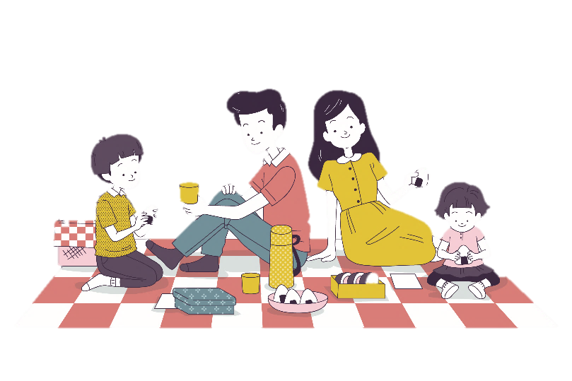
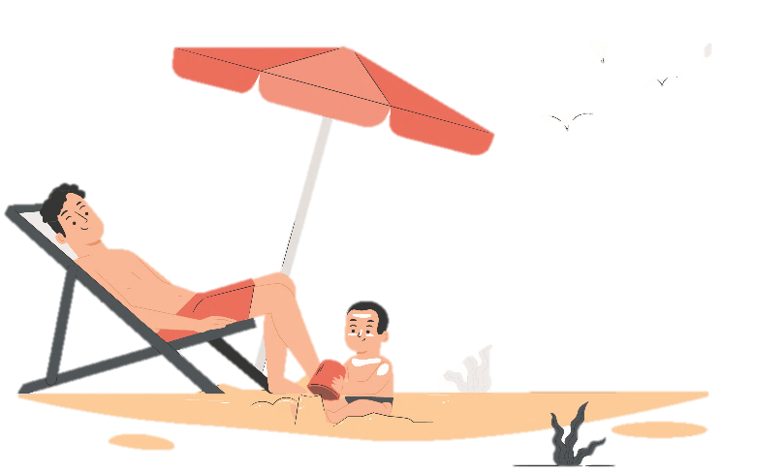
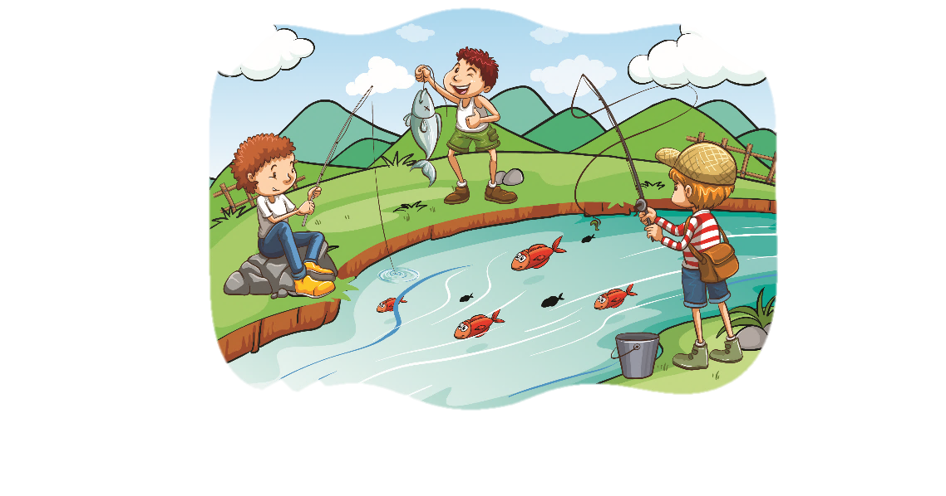
N.
Read for fun.
Picnic
Picnicking with family is a must. It is a relaxing activity during weekends or holidays. People go to the park, the side of a river, or a mountain slope. Enjoying the fresh air and seeing beautiful scenery is a very good way to spend time with family. Besides being a leisure activity, picnic also makes the relationship among the family members stronger. Picnic is a good way to rest from busy days at school and work.

