Slide 1
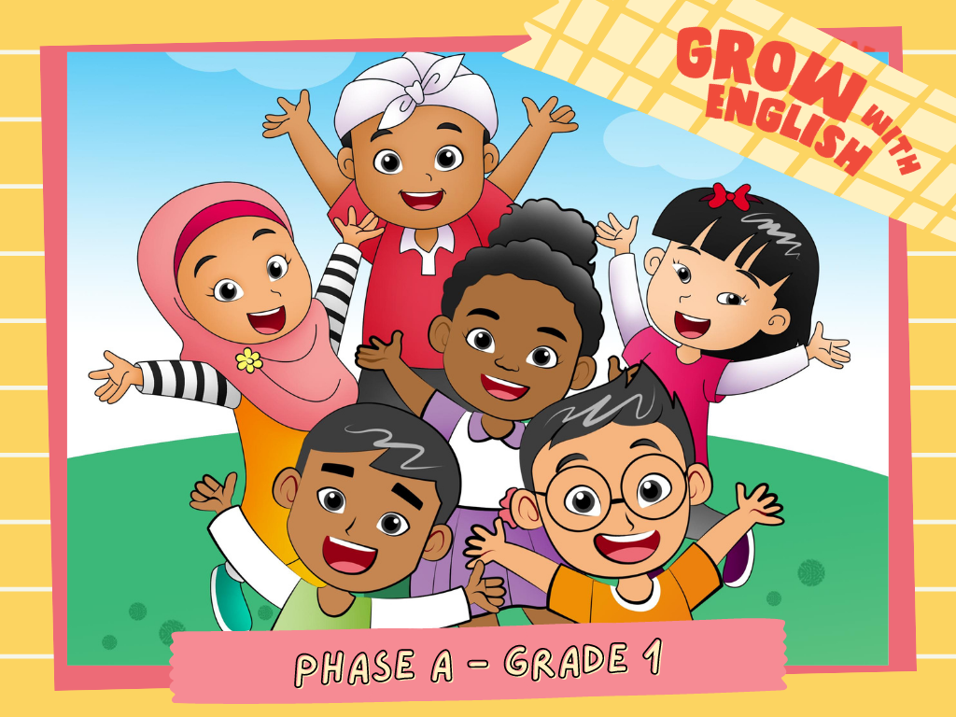

Slide 2

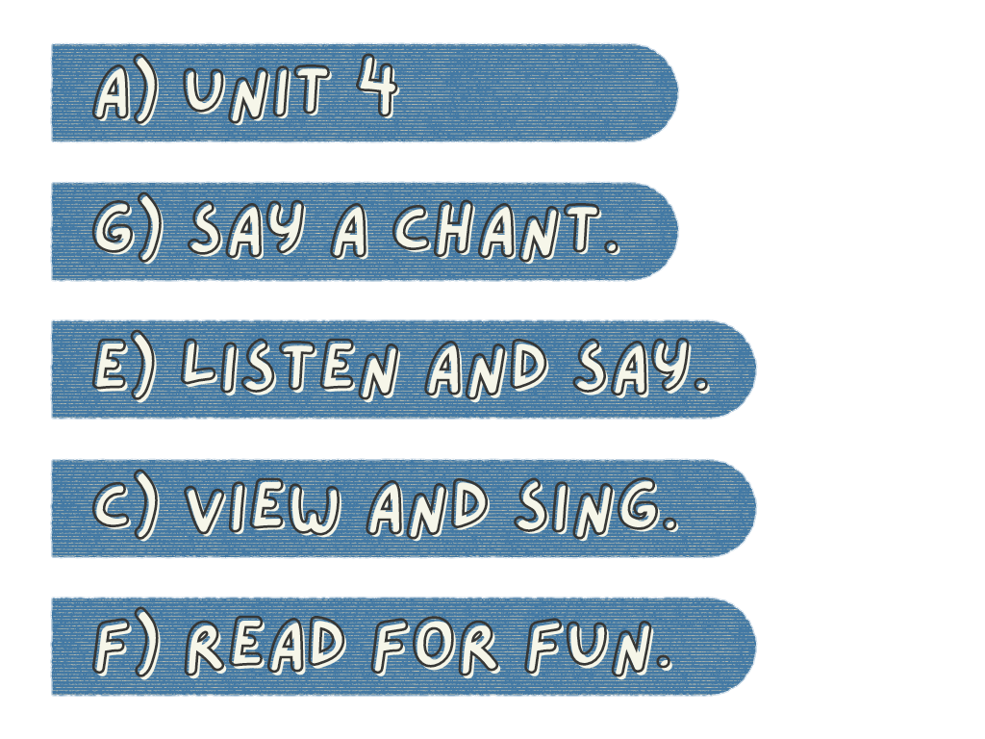
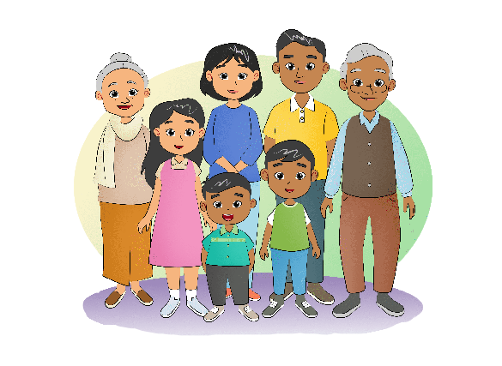
My Family
Describe
your family!

Slide 3
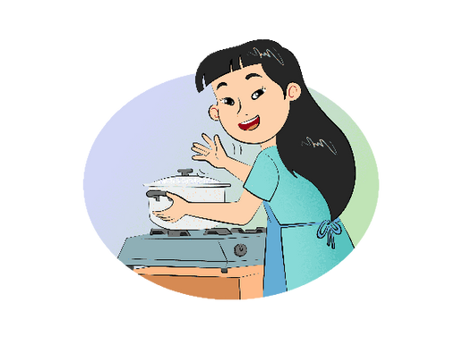
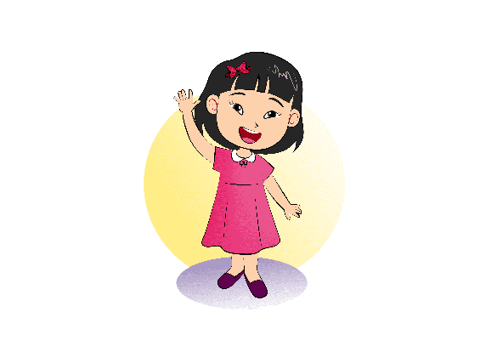
Who's she? Who's she?
Who is she?
She's my mother,
she's my mom.
Who is she?
She's my mom.
Who's she?
Who's she?

Slide 4
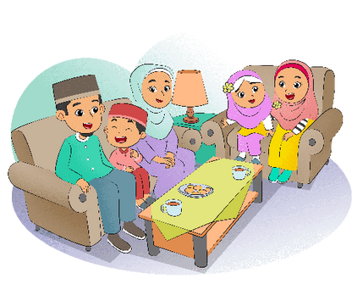
Hello. This is my family.
This is my father.
This is my mother.
I have one sister and one brother.
This is Aswar. He is my brother.
This is my sister. She is Laila.

Slide 5
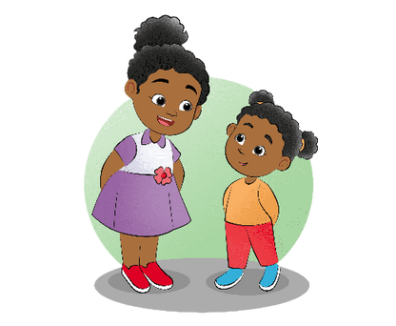
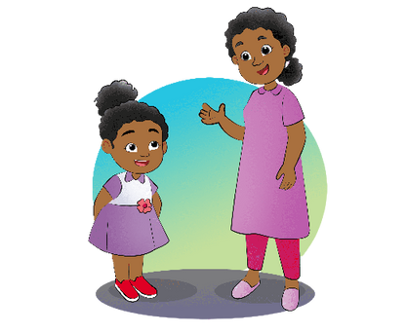
One, two, three
Who do you see?
I see my mom looking at me.
One, two, three
Who do you see?
I see my sister looking at me.

