Slide 1


Slide 2

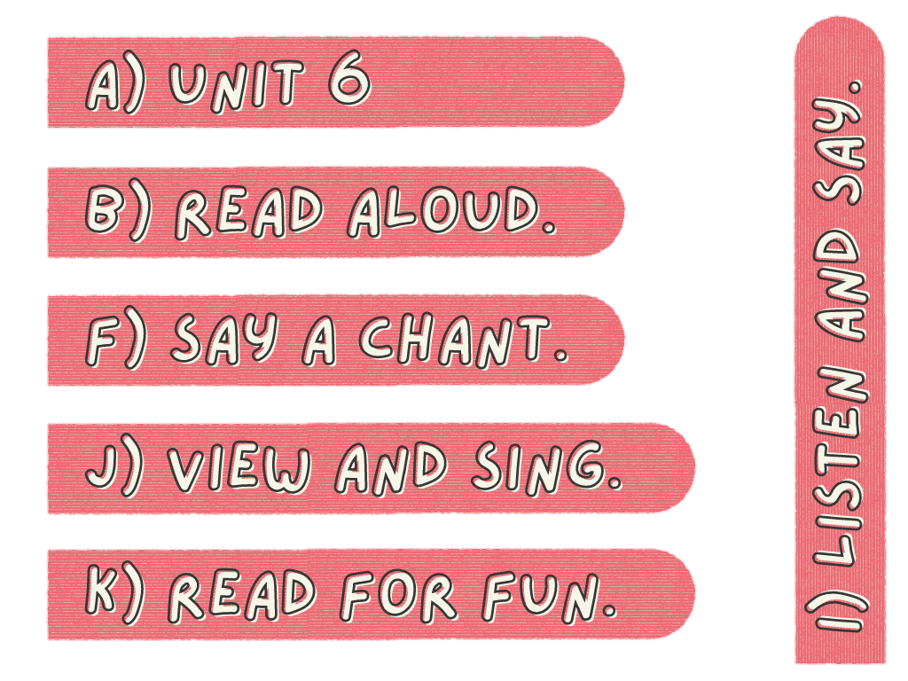
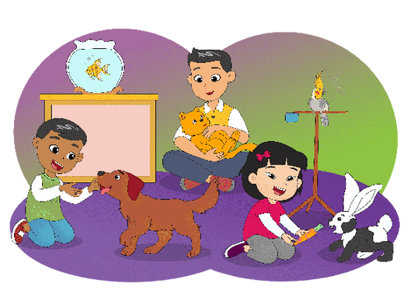
My Pets
Do you have pets?
Please describe
your pets!

Slide 3
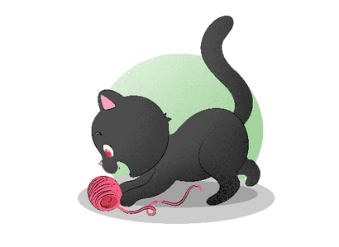
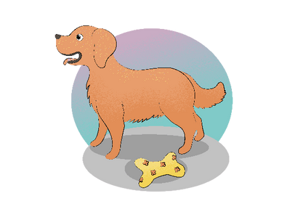
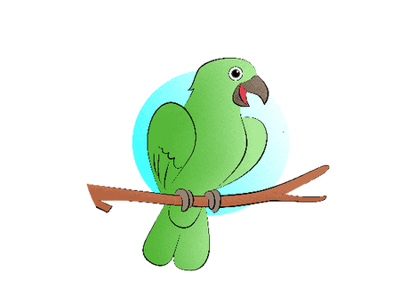



Slide 4

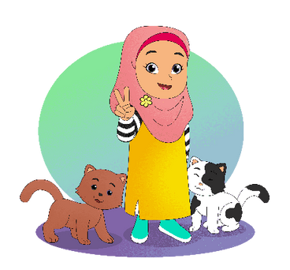
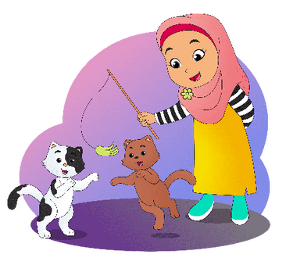

two cats,
two cats
I have
two cats.

Slide 5
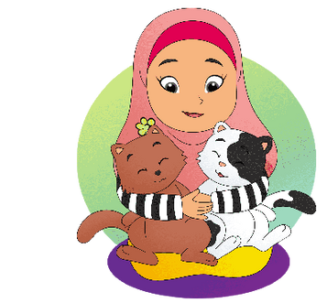

two cats,
two cats
they are
my pets.

Slide 6
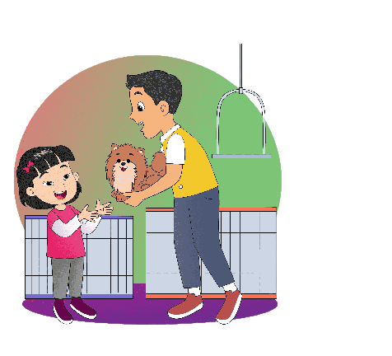

Give me
a dog, please.
Here.
Thanks.

Slide 7

Give me
some fish, please.
Here.
Thanks.

Slide 8


This Is the Way
This is the way we pet a cat,
pet a cat, pet a cat.
This is the way we pet a cat,
so early in the morning.
This is the way we feed the fish,
feed the fish, feed the fish.
This is the way we feed the fish,
so early in the morning.

Slide 9
Momo the Lazy Cat
This is Momo the cat.
All he does is eat and sleep.
Sometimes he plays.
But he sleeps most of the time.
He is a lazy cat.

