Slide 1
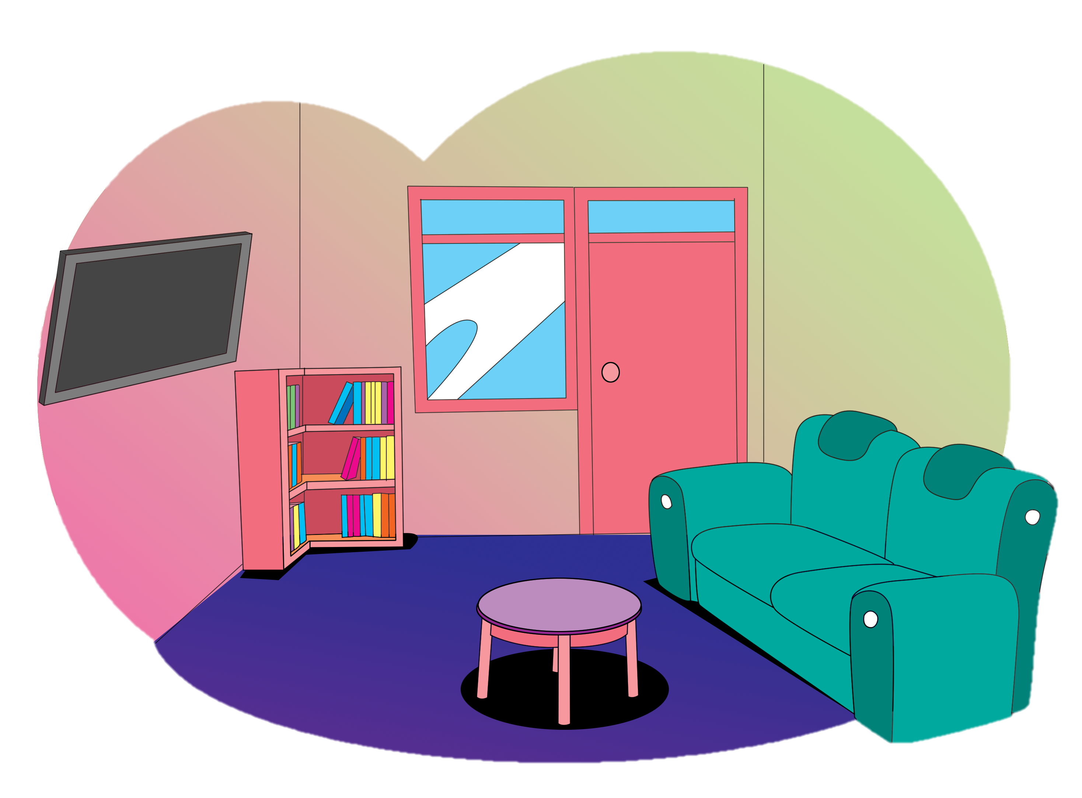
My Room Is not Big but
I Like It
3.
Ask and tell about locations
Describe a living room
Give instructions
Theme: My Living Room

Slide 2
B.
Read aloud.
an armchair
a painting

Slide 3
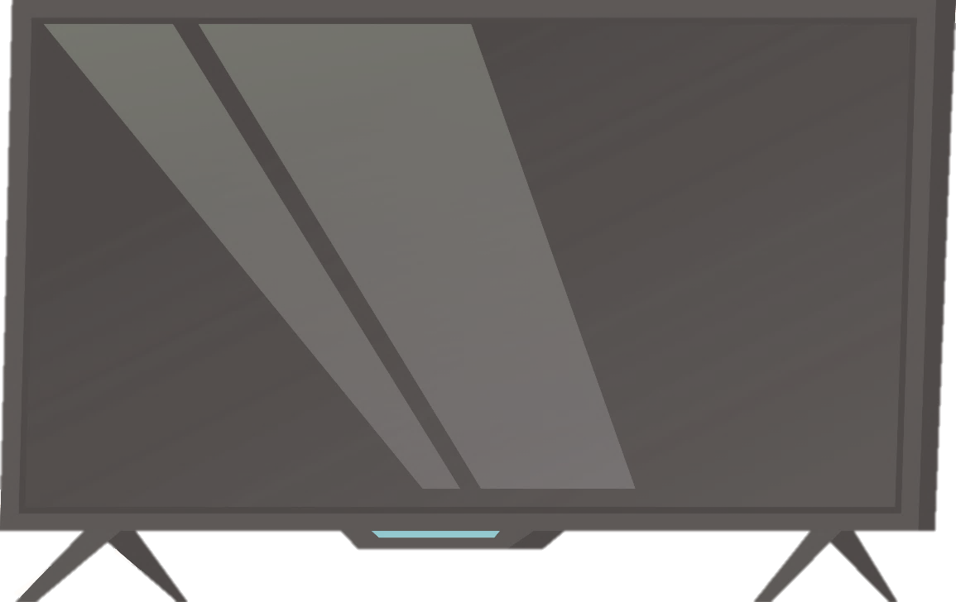
B.
Read aloud.
a sofa
a TV

Slide 4
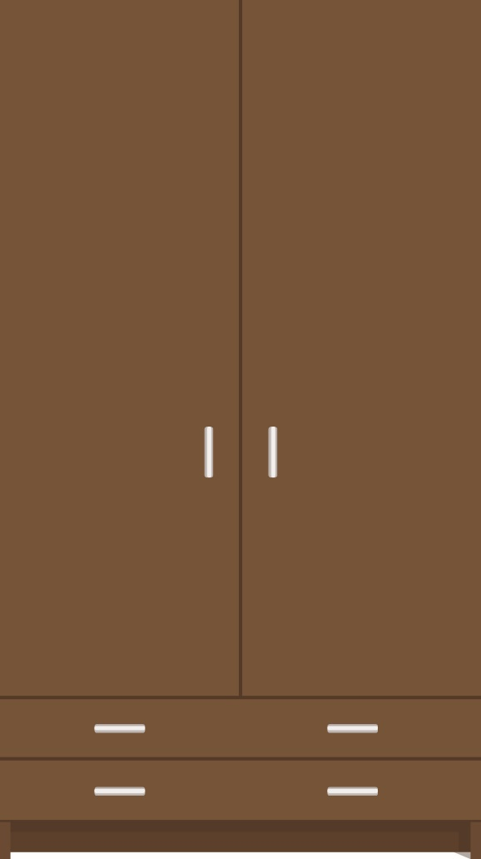
B.
Read aloud.
a cupboard
a mirror

Slide 5
B.
Read aloud.
a radio
a bookcase

Slide 6
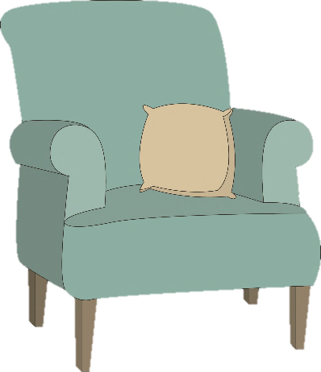
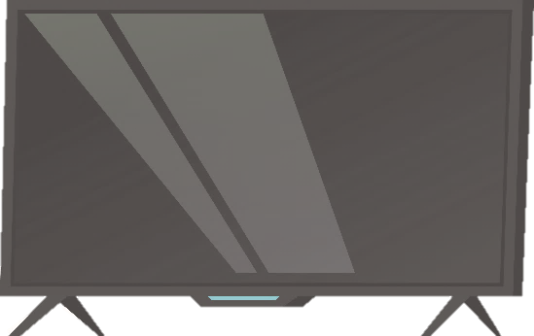
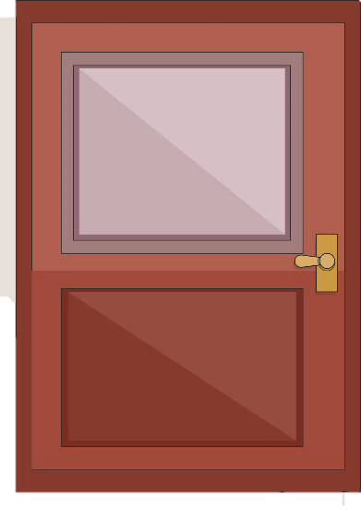

C.
Say a chant.
Living Room
Door
Window
Sofa
Armchair
TV
Picture
That’s my living room.
Notes:
lukisan sama jendelanya kroak

Slide 7
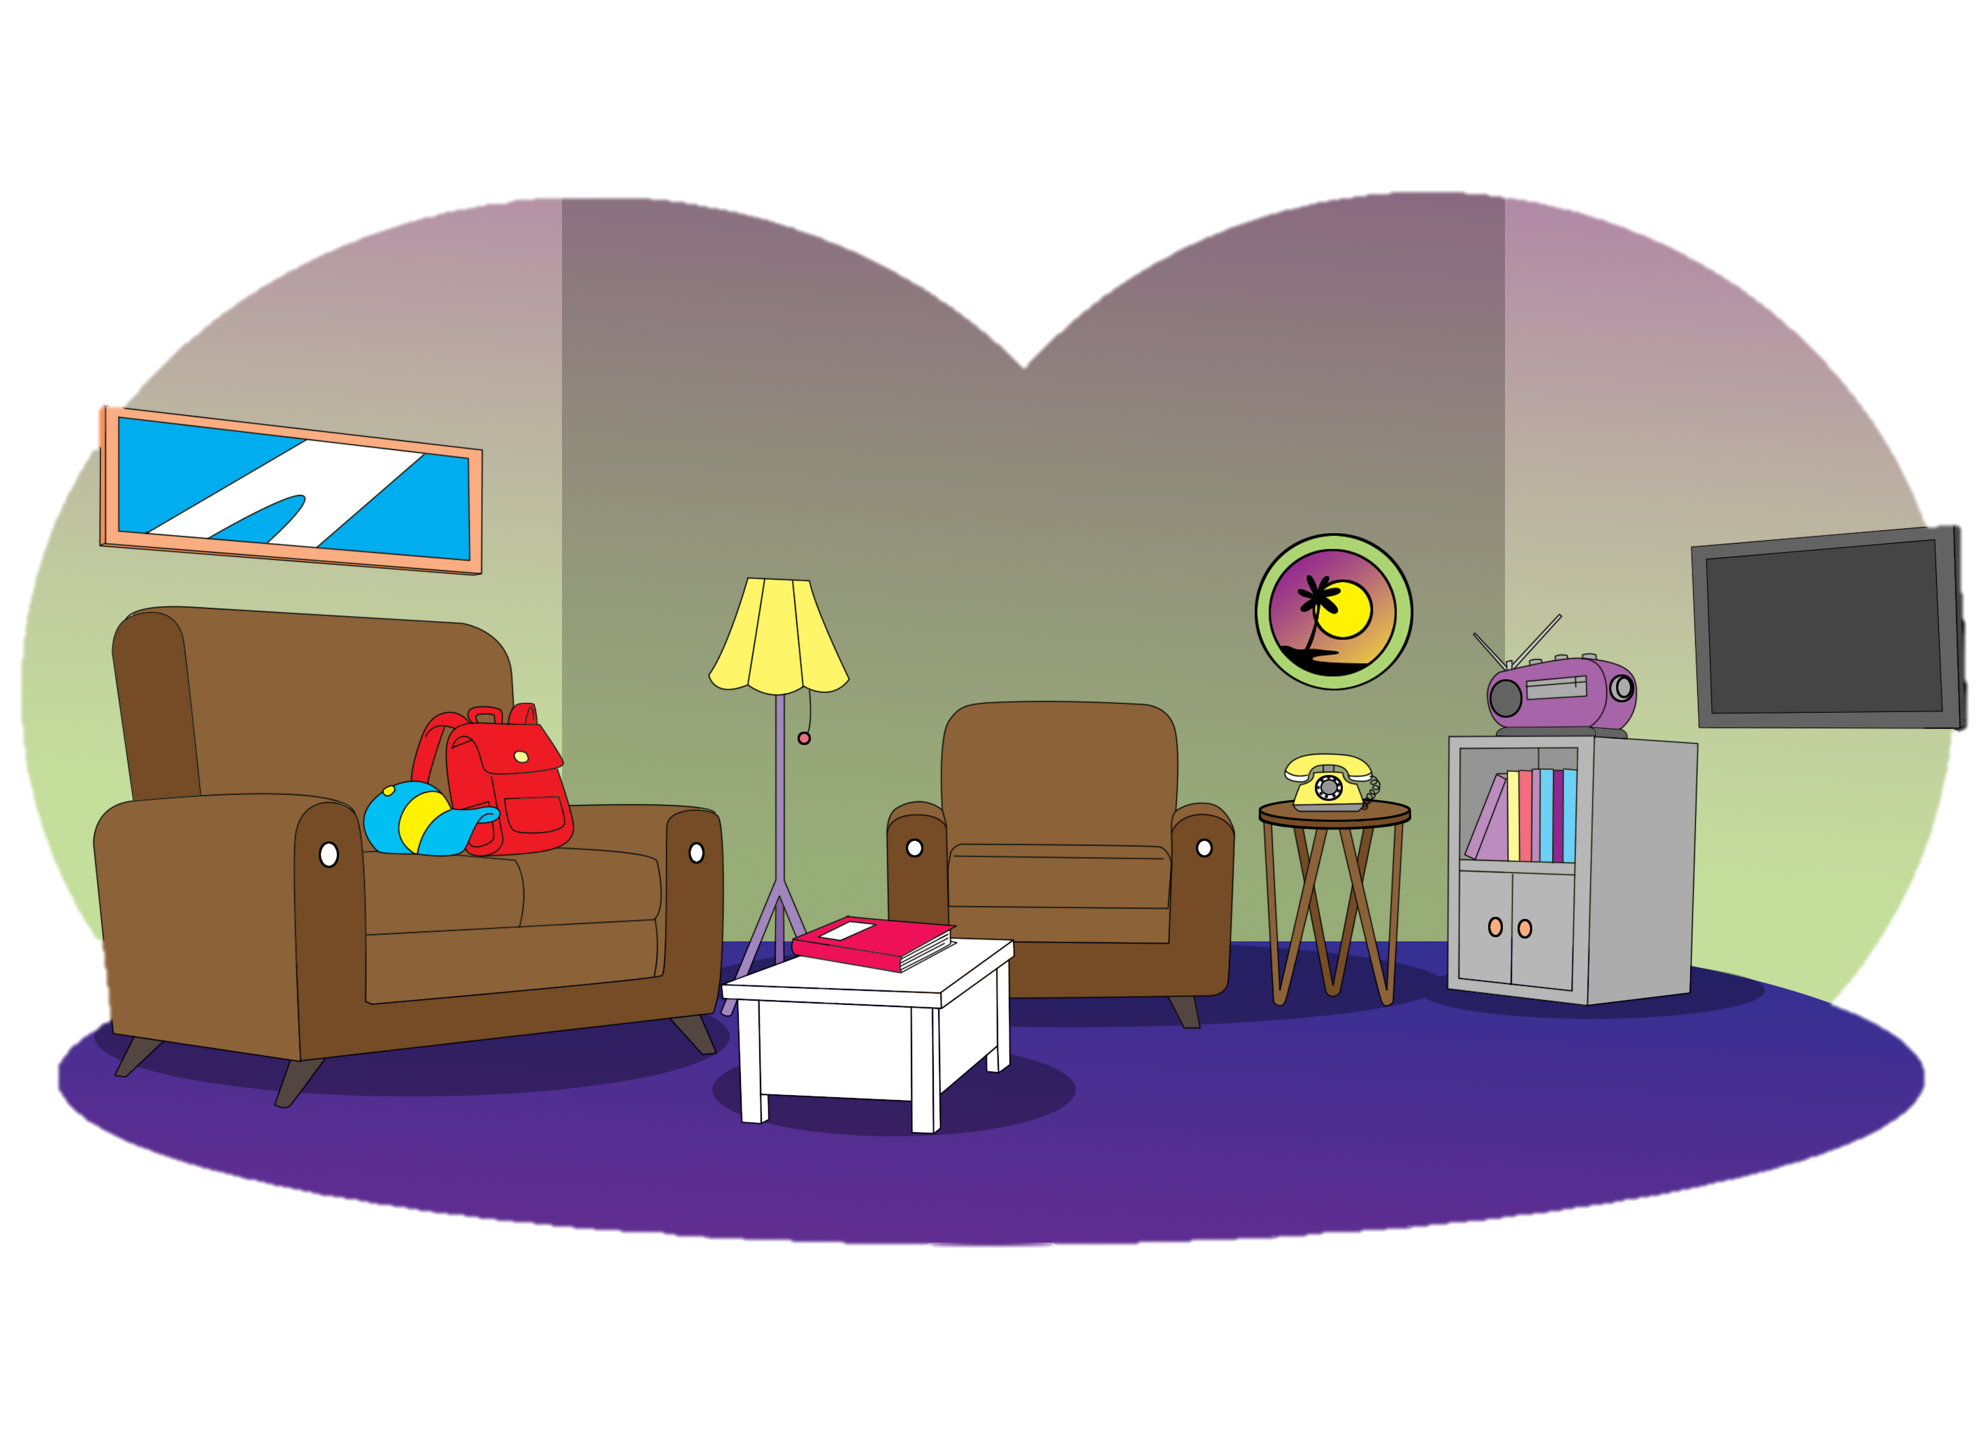
G.
Play a memory game.
There’s a mirror on the wall.
There are two armchairs beside the table.
No, there aren’t.
Yes, there is.

Slide 8
H.
Listen and do.
Sweep the floor.
Mop the floor.

Slide 9
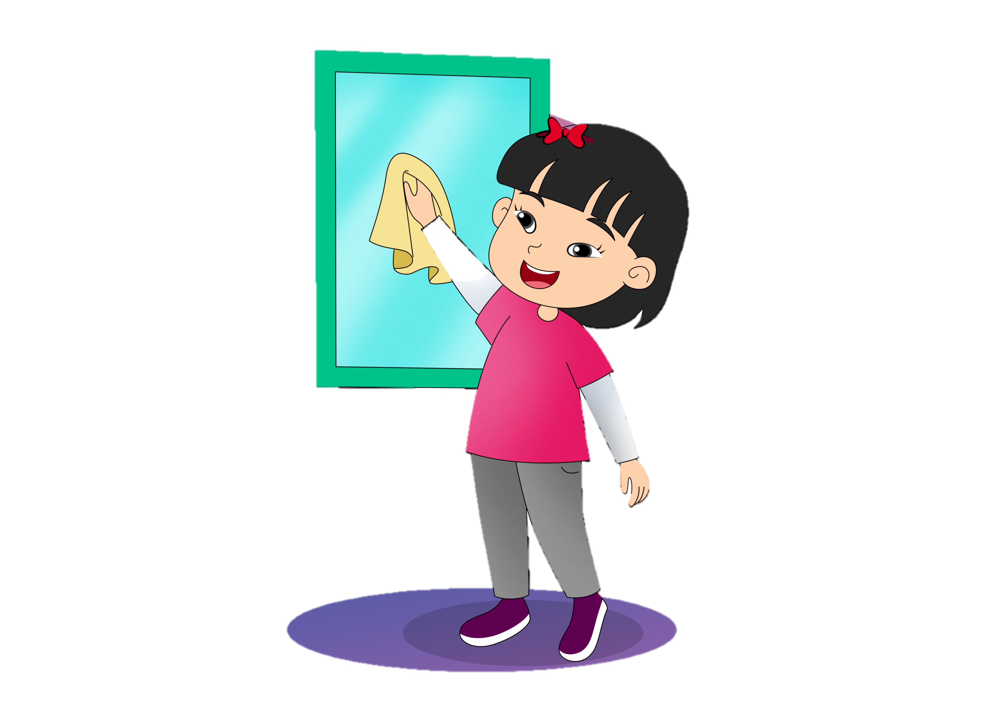
H.
Listen and do.
Clean the window.
Dust the sofa.

Slide 10
J.
Read aloud.
a tidy living room

Slide 11
J.
Read aloud.
a messy living room

Slide 12

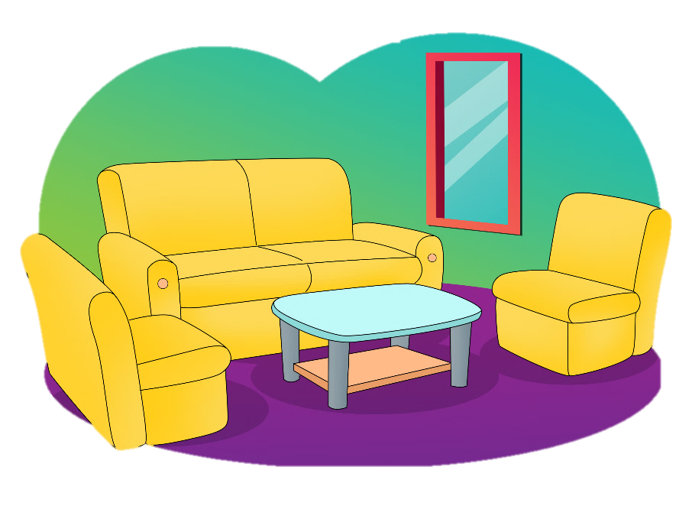
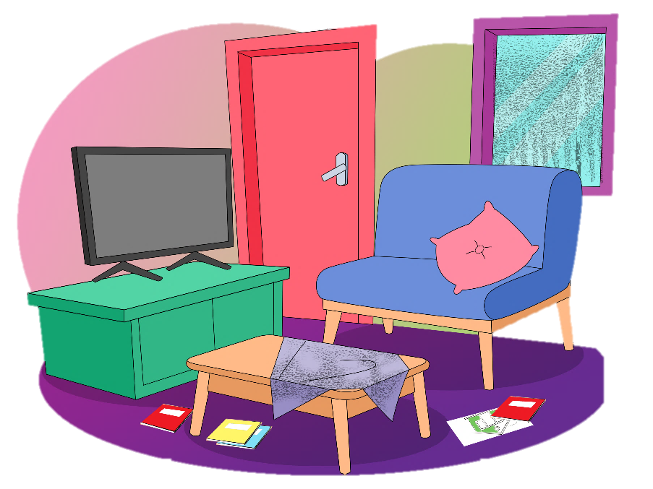
L.
View and sing.
Living Room
It’s a tidy living room,
living room, living room.
Big sofa, table, and chairs,
What a tidy room!
It’s a messy living room,
living room, living room.
Purple window, TV, and red doors,
What a messy room!

Slide 13
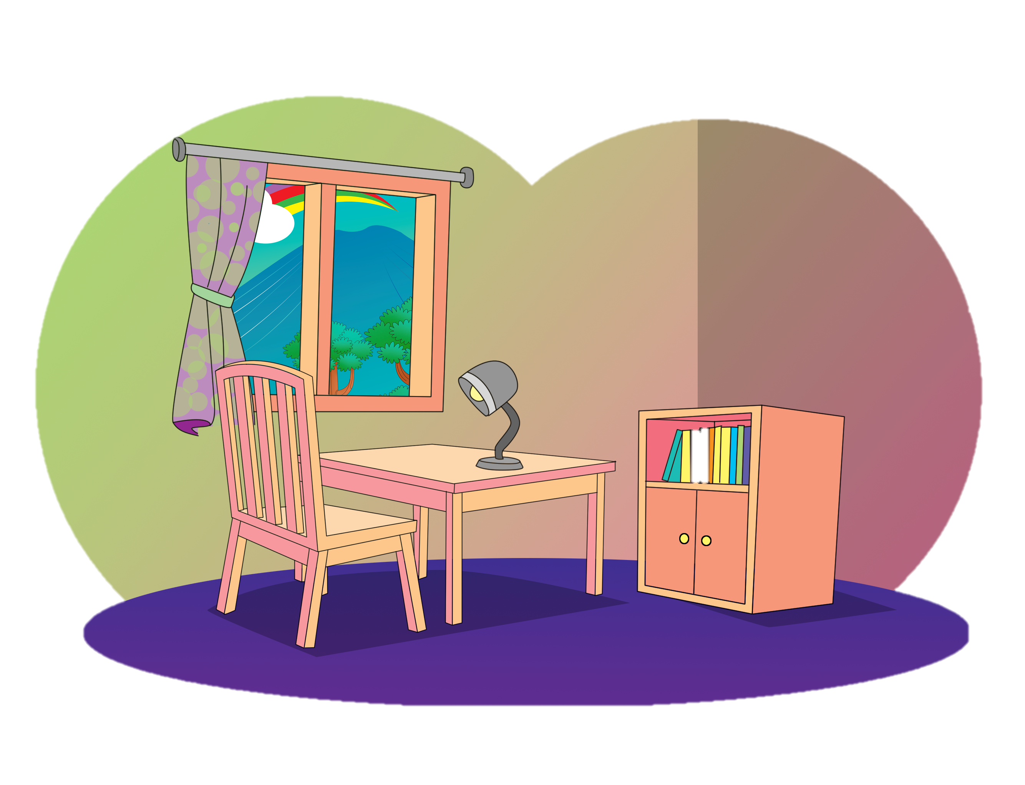
N.
Read for fun.
My Room
Look, this is my room. It has a window. I can see outside through the window. There is a desk below the window. I usually study at the desk. I have a lamp on the desk. I use the lamp when it is dark. Near the desk there is a small bookcase. I keep my books there. My room is not big but I like it.

