Slide 1
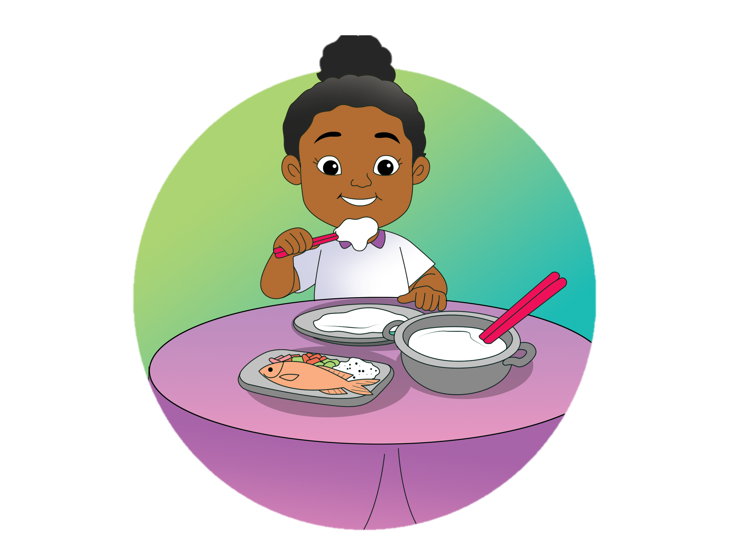
Papua Is Famous for
Its Papeda
6.
Ask and tell what to eat and drink
Order meals
Describe taste
Theme: Food and Drink

Slide 2
B.
Read aloud.
a burger
fries
sausages
water

Slide 3
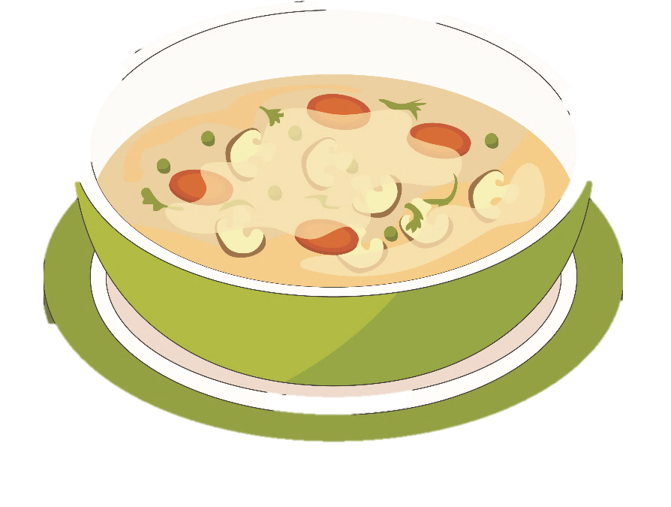
B.
Read aloud.
tea
spaghetti
porridge
soup

Slide 4
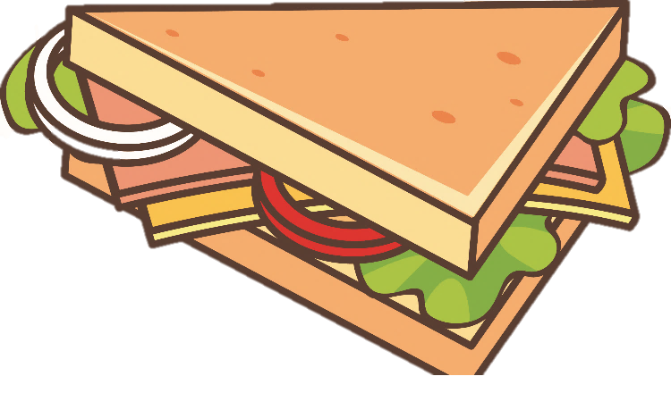
B.
Read aloud.
fried rice
lemonade
an egg
a sandwich

Slide 5
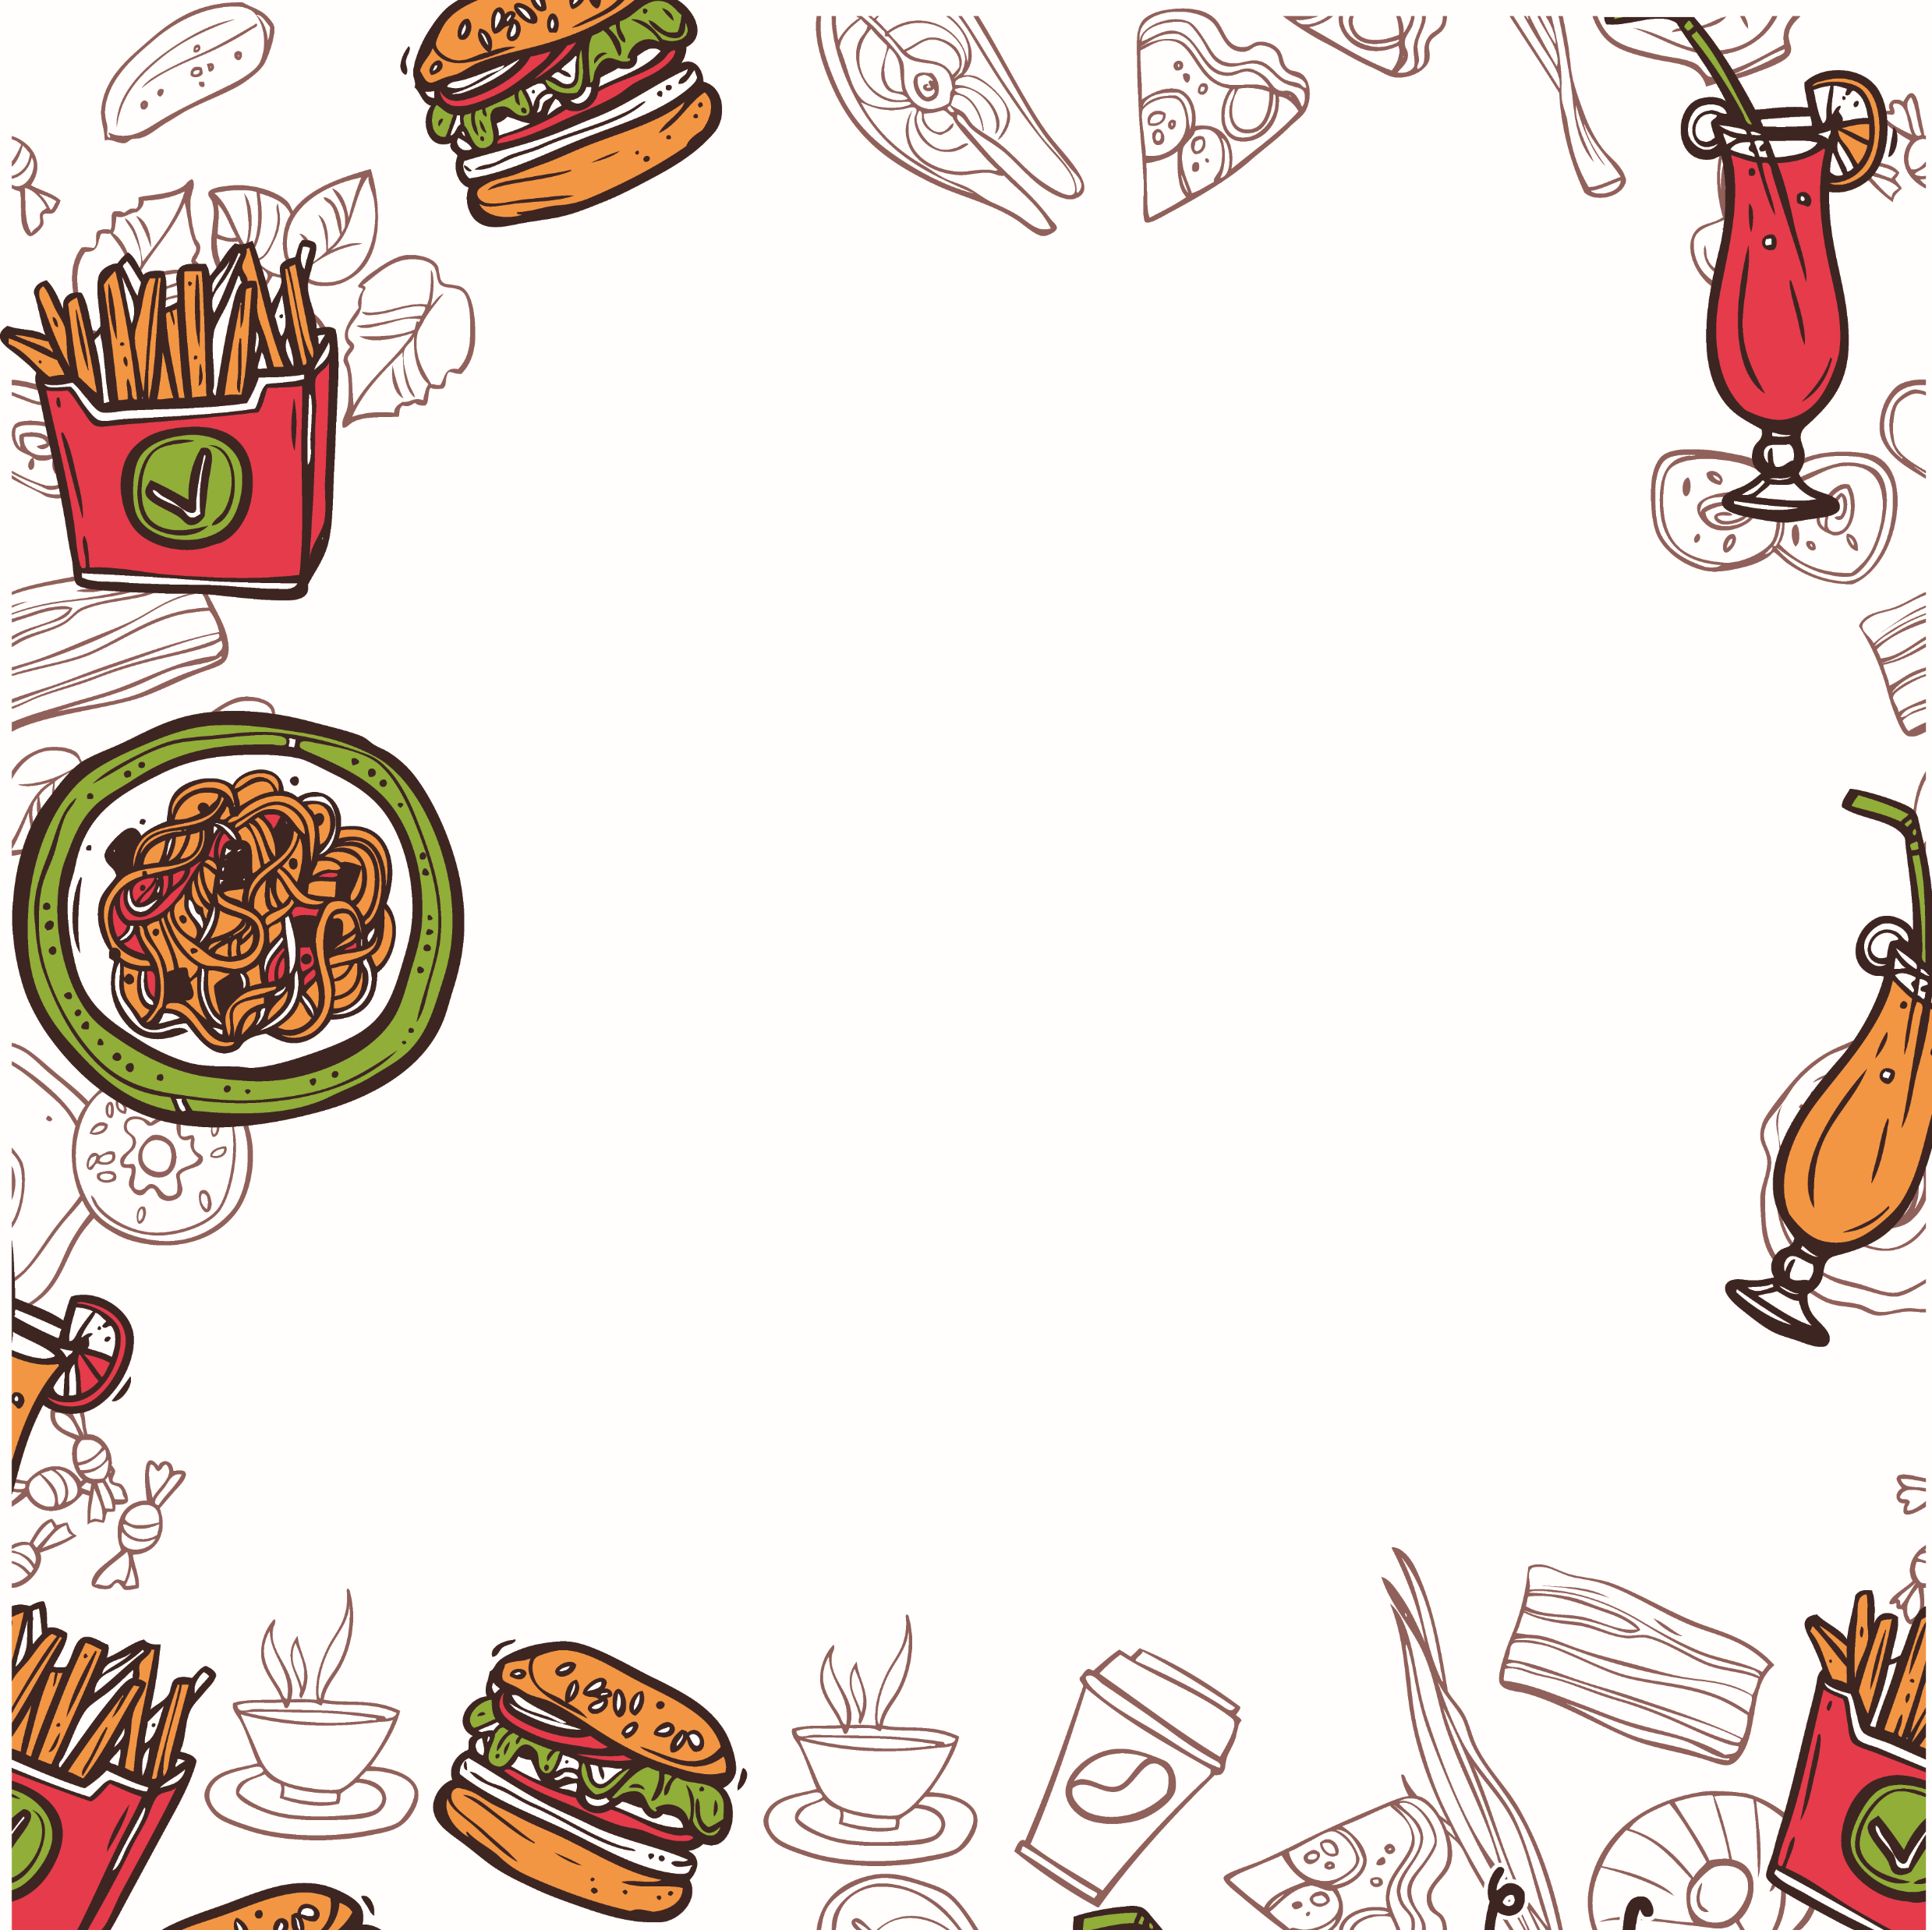
F.
Say a chant.
It Is Sweet
It is sweet.
Really?
Yes, it is.
It is salty.
Really?
Yes, it is.
It is yummy.
Really?
Yes, it is.

Slide 6
G.
Read and loud.
The cheese is salty.
The chocolate is sweet.

Slide 7
G.
Read and loud.
The ice cream is sweet.
The egg is salty.

Slide 8
I.
Listen and do.
Look at the menu.
Order the meal.

Slide 9
I.
Listen and do.
Enjoy the meal.
Pay the bill.

Slide 10
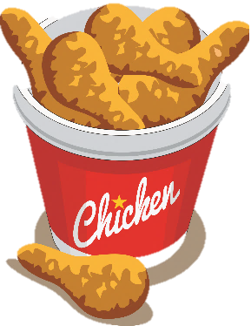
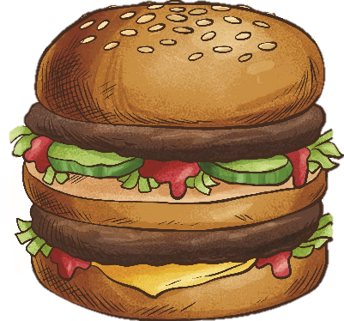
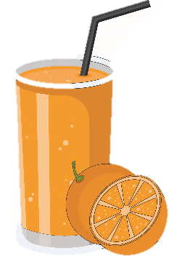
L.
View and sing.
Eat The Chicken
(sung to the tune of ‘Are you sleeping?’)
Eat the chicken, eat the chicken.
Drink the tea, drink the tea.
I like chicken and tea,
I like chicken and tea.
Yum, yum, yum.

Slide 11
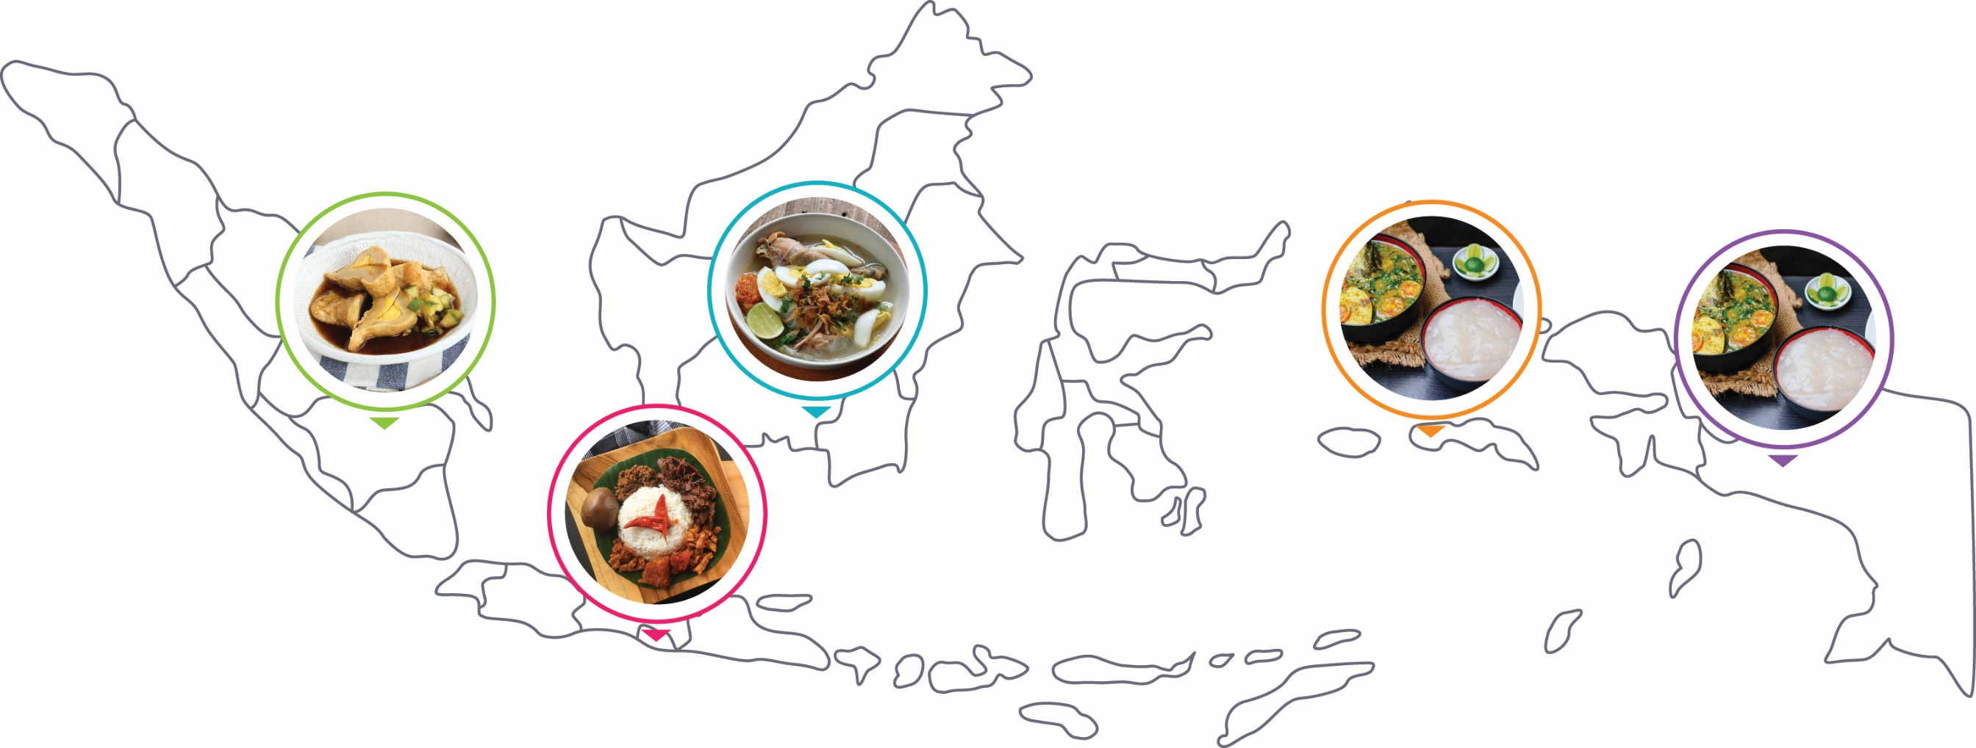
N.
Read for fun.
Indonesia is a big country.
It has many famous foods.
Palembang is famous for its empek-empek.
Jogja is famous for its gudeg.

Slide 12
N.
Read for fun.
What about Banjarmasin on Kalimantan?
What is it famous for?
Well, Banjarmasin is famous for its Soto Banjar.

Slide 13
N.
Read for fun.
What about Papua?
Papua is famous for its papeda.
Papeda is also popular in Maluku.
Is it all?
No.
What is the famous food in your place?

