Slide 1
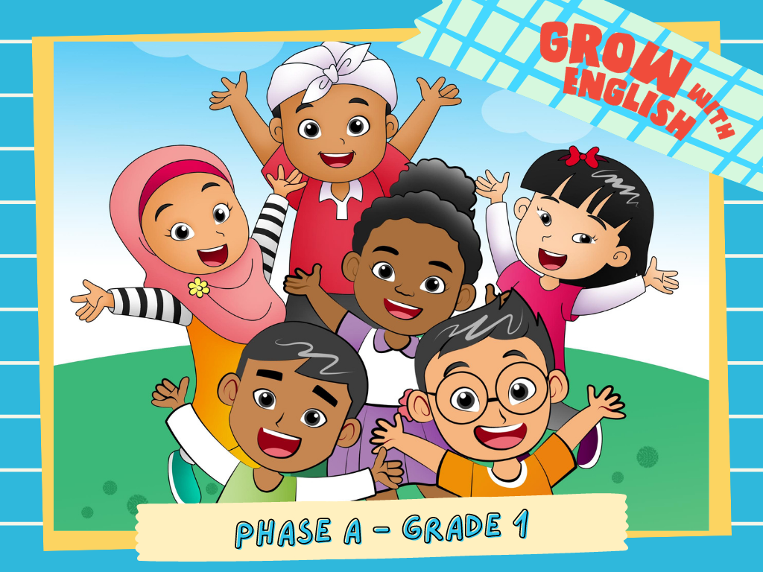

Slide 2
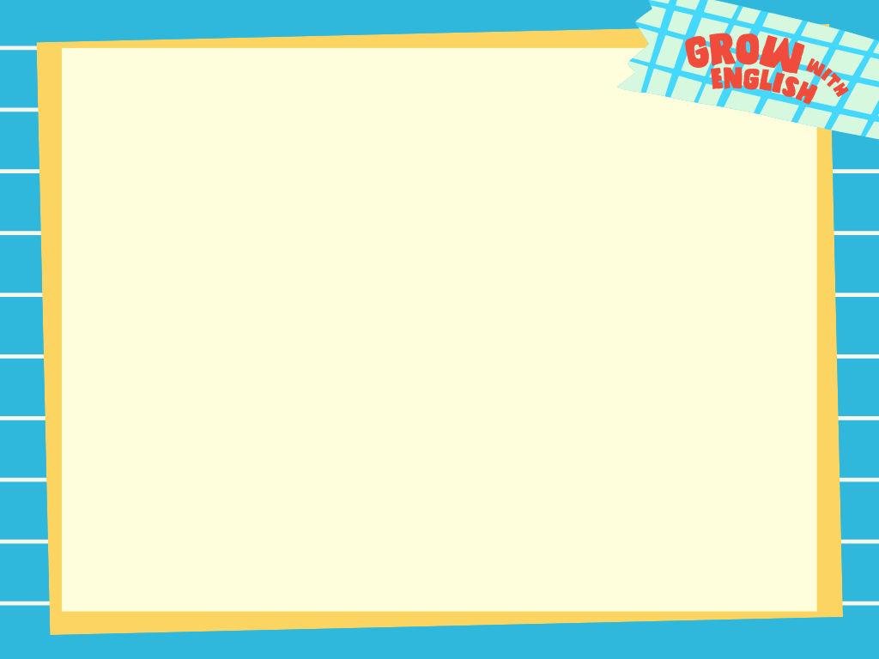
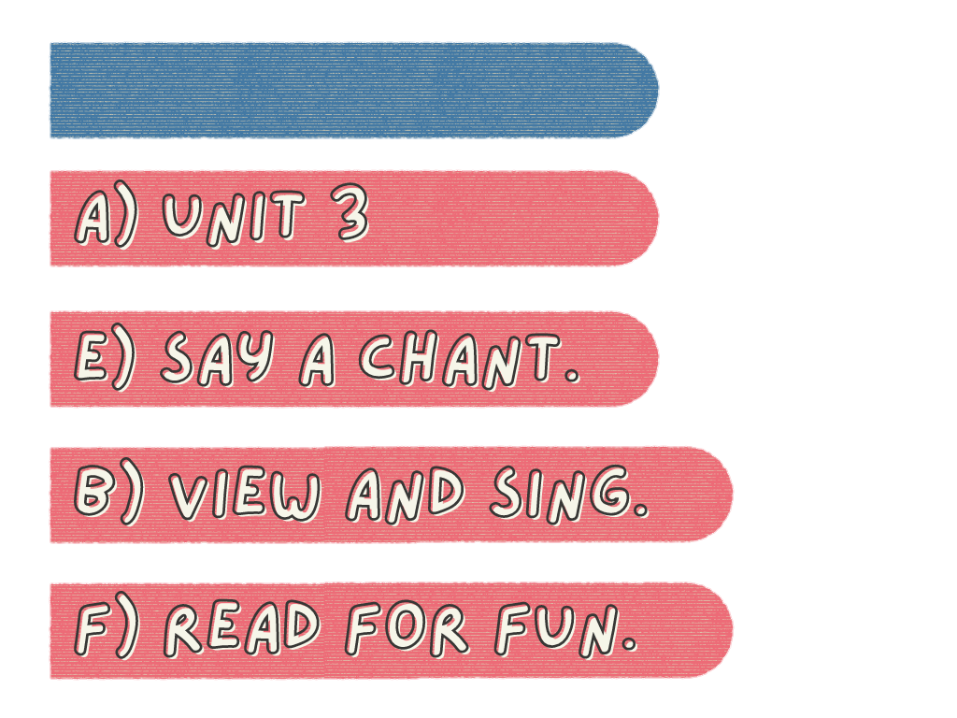
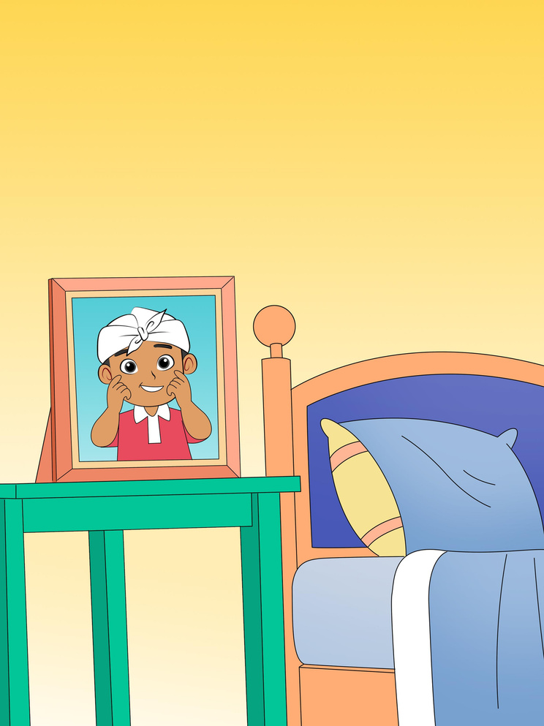
My Face
Describe your face!

Slide 3
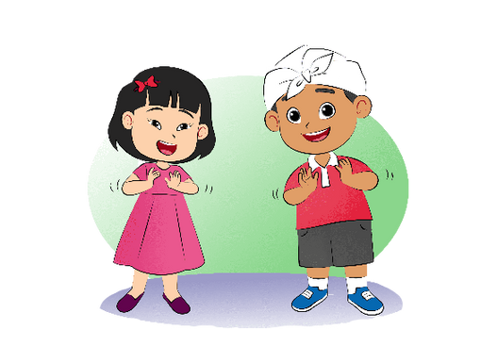
My Eyes, My Ears, My Nose
My eyes, my ears, my nose, my mouth.
My eyes, my ears, my nose, my mouth.
My eyes, my ears, my nose, my mouth.
We all clap hands together

Slide 4

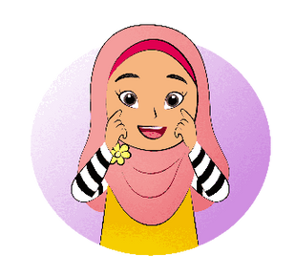

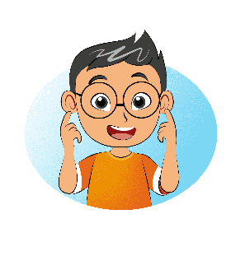
two eyes
two eyes
one, two
two ears
two ears
one, two

Slide 5
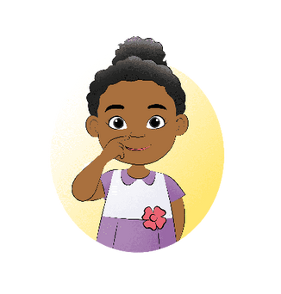
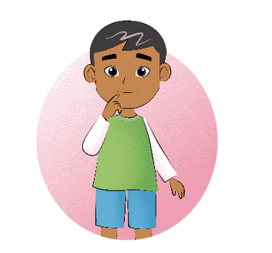
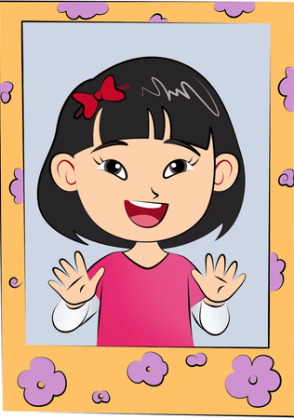


one mouth
one nose
a happy face
for you.
that's
true

Slide 6
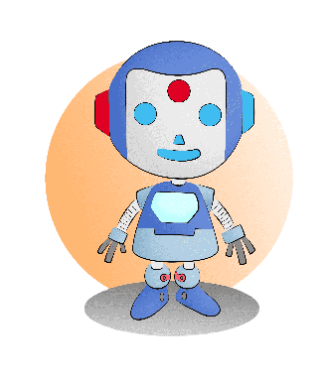
My Robot
I have a robot.
It has three eyes.
One is red, two are blue.
It has two ears.
One is red, one is blue.
It has one nose and one mouth.
All are blue.

